Slide 1
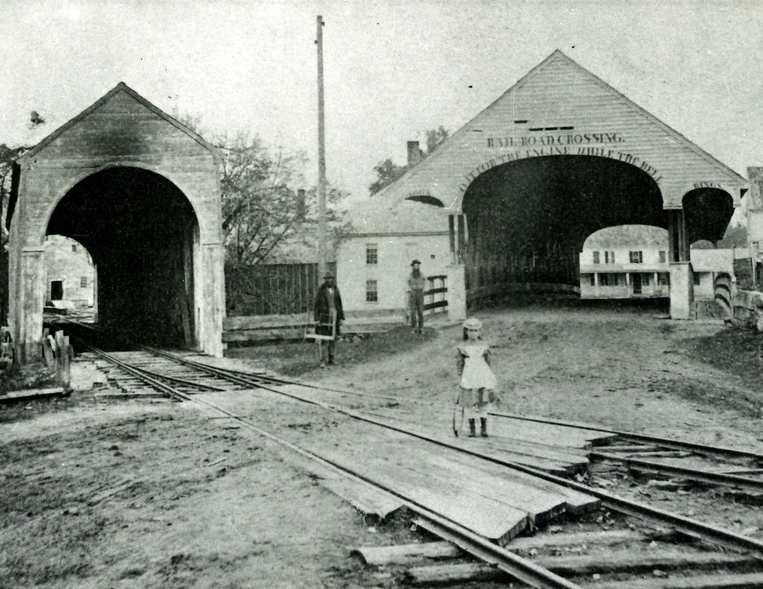
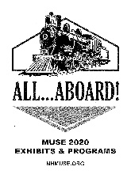
ALL…ABOARD! Economic, Social, & Environmental Change During New Hampshire’s Railroad Era
Driving Tour of Railroad Points of Interest in Hopkinton, N.H.
Hopkinton Historical Society Celebrating Hopkinton History Since 1859
300 Main St. Hopkinton, NH 03229
603-746-3825 • nhas@tds.net • www.HopkintonHistory.org

Slide 2
Dedication
We proudly dedicate our 2020 “All…Aboard” Driving Tour to Hopkinton Historical Society Trustee Allita Paine.
Allita has been a board member of the Society for ten years. During that time she has filled many roles, including Secretary, Collections Committee Chair, Vice President, and President. Allita has also been a faithful volunteer at the Society’s table at the Farmers’ Market, as well as a regular contributor to our exhibits and programs.
We are so appreciative of Allita’s willingness to step up to almost any role that has been asked of her, and even more appreciative of her approach. Allita is thoughtful, willing to put in the hard work, and realistic yet optimistic.
One of Allita’s contributions has been development of the Society’s Learning from History Forums. These forums begin with a look back in time at a particular topic to spark discussion by participants of current experiences and lessons learned, if any, from history. The forum provides a non-judgmental setting to share a variety of points of view, and has been a popular program.
A second contribution has been researching and writing pieces for our summer exhibits. Topics have included the 1918 Influenza Pandemic; Sugar Hill’s One-Room Schoolhouse; Use of Herbal Medicine by Native Americans and Early Colonists; and Hopkinton’s Tramp Houses. Each piece has been a gem – thoroughly researched, well-written, and a meaningful contribution to the history of our town.
Finally, it was Allita who first suggested several years ago a summer exhibit on the history of the railroad in Hopkinton. While no one could have imagined how the world would be turned upside down as the result of coronavirus (although Allita could tell us exactly what happened during the last pandemic!), we knew we would do whatever it takes to share the history of Hopkinton’s railroad.
Thank you, Allita, for your many contributions, and for the care and consideration you give to all matters. We are most appreciative.
The Staff and Trustees of Hopkinton Historical Society
Hopkinton Historical Society Celebrating Hopkinton History Since 1859

Slide 3
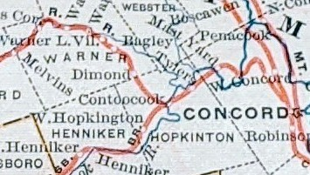
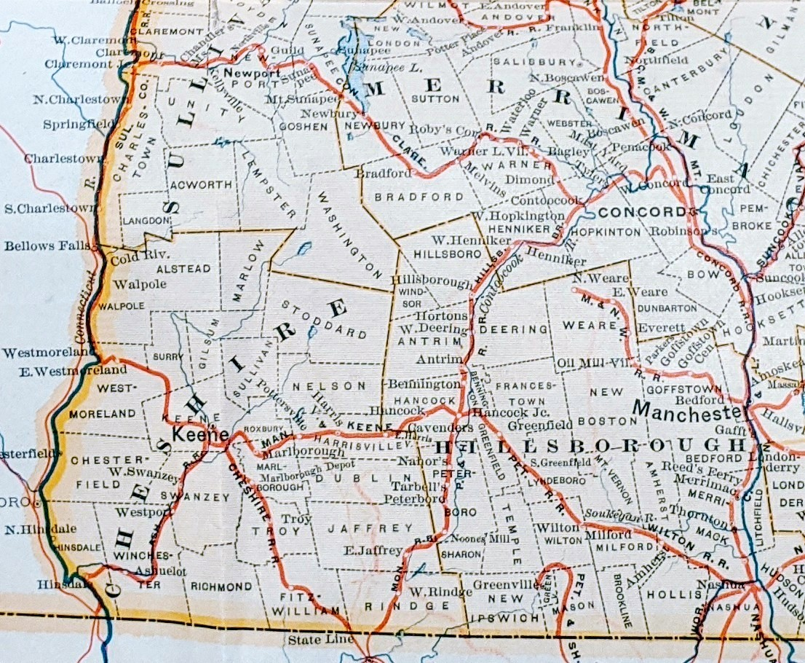
About the Driving Tour
In March 2020, Hopkinton Historical Society was in the middle of planning its summer exhibit, scheduled to open in early June, as part of a 16-member collaboration (MUseums Sharing Experiences, or MUSE) that had organized eight exhibits and more than 30 programs on the economic, social, and environmental impact of the railroad in New Hampshire.
When the pandemic forced the closing of the Society in mid-March, we knew we still wanted to move forward somehow with our summer exhibit. Given the continued uncertainty regarding opening dates and people’s comfort levels with gathering in groups indoors, we decided the best approach was to take our exhibit on the road! Specifically, to put together a driving tour that can be downloaded from our website, www.HopkintonHistory.org, or followed on Clio, a downloadable app that allows you to view driving tours of sites of historic and cultural interest. Clio can be accessed via its website or on a mobile device.
Thank you to every individual and organization that has contributed to the driving tour, including but not limited to, Craig Bohanan, Steve Lux, Fred Nystrom, Allita Paine, David White, and the Contoocook Riverway Association.
We hope you enjoy our driving tour. If you have images or stories you would like to share, please contact us at 603-746-3825, nhas@tds.net, or www.HopkintonHistory.org.
About MUSE: MUSE is a group of local museums, historical societies, libraries, and other organizations in central N.H. that share resources and ideas. Since 2012, the group has collaborated on four exhibits and series of programs. For more information, go to https://www.nhmuse.org/.
This project was made possible with support from New Hampshire Humanities, in partnership with the National Endowment for the Humanities. Learn more at nhhumanities.org.
Hopkinton Historical Society Celebrating Hopkinton History Since 1859
“Railroad Map of New Hampshire” from New Hampshire Railroad Commissioners Report 1885. Detail of map shows the three stations in Hopkinton: Tylers [sic], Contoocook, and W. Hopkington [sic]. HHS collection.

Slide 4
Introduction and Overview of the Route
Introduction
There are many ways to approach the social history of the railroad – how it expanded markets for farmers, increased tourism, expanded mobility for rural communities, and its affect on mills and factories along the Contoocook River. However, too often when people think of the railroad today, it is a romanticized version of its history. People reminisce about “simpler times” and quote from Thornton Wilder’s Our Town: “If you hold your breath you can hear the train from the station all the way to Contoocook.” This sentimentalized version sometimes ignores aspects of the railroad – the immigrant laborers, those displaced from their homes along the river, and the townspeople and other investors who purchased bonds that paid for the railroad – which we have tried to include in this driving tour.
We hope you enjoy this driving tour, that you learn something you didn’t know before, and perhaps gain a different perspective. Thank you for joining us!
Overview of the Route
Note: Please be respectful of private property. If you are driving, pull off the road completely and do not block driveways or roads. If you get out of your car, make sure you are on public land or have the owner’s permission to be on it. We suggest the tour be done during daylight hours.
Although the stops on this tour can be done in any order, we have chosen to begin at the Tyler Station (Stop #1), which was the first stop in Hopkinton headed west from Concord. Next is the home of Joseph Barnard, (Stop #2) who supplied the lumber for the Contoocook Valley Railroad and acted as building agent for the railroad. We stop briefly in Hopkinton Village (Stop #3) to learn about an inn that included the convenience of arriving by rail in its advertising and a popular summer camp.
From Hopkinton Village we move to Contoocook Village (Stop #4), where the Contoocook Depot, tramp house (no longer standing), and oldest covered railroad bridge are located. We also look at the various workers that built and ran the railroads.
The railroad line split right after the covered bridge (travelling west), with the Contoocook Valley Railroad heading west/southwest through West Hopkinton, and the Concord & Claremont line heading northwest through Warner and Bradford.
On Cedar St. in Contoocook Village (Stop #5) we learn more about some of the businesses that utilized the railroad, as well as railroad owners and investors.
The next stop follows the route of the Concord and Claremont line, in what has now become the Stevens Rail Trail (Stop #6).
The final stop on the driving tour is West Hopkinton, where the West Hopkinton Station was located (Stop #7).
Hopkinton Historical Society Celebrating Hopkinton History Since 1859

Slide 5
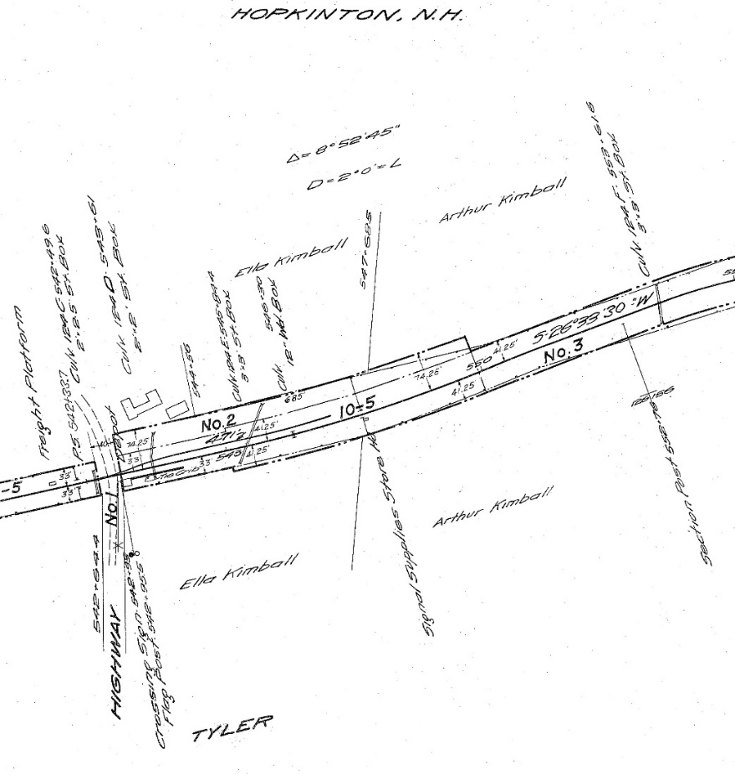
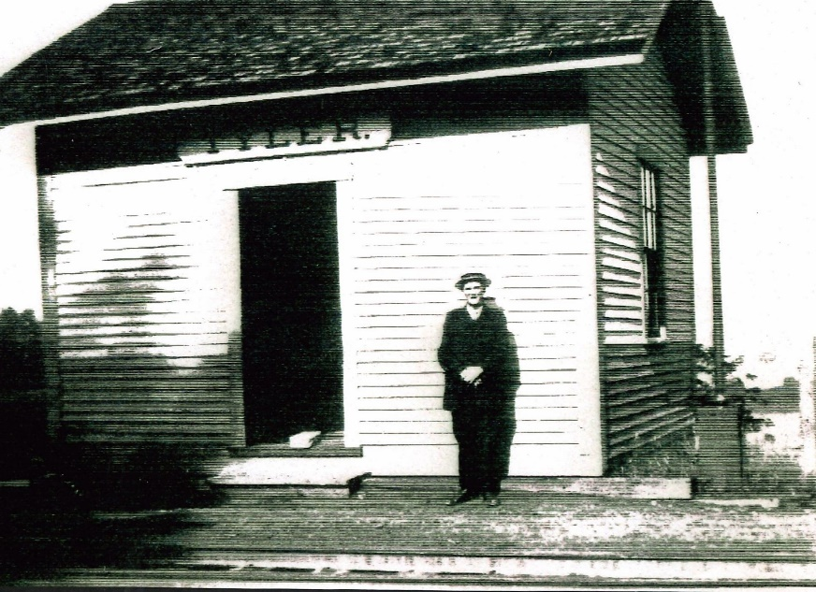
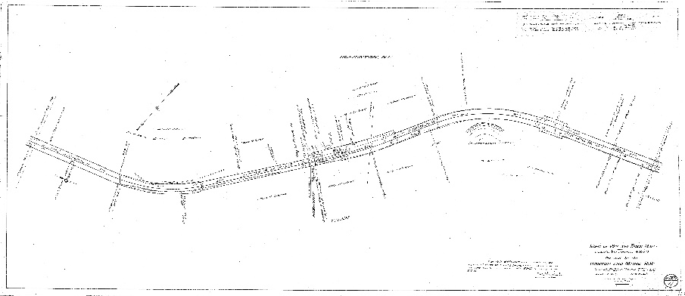
Stop #1 Tyler Station near 833 Penacook Rd.
1914 B&M Valuation Map and detail of Tyler Station, Hopkinton, N.H. Courtesy of Boston & Maine Historical Society.
Parking for Stop #1 is on Penacook Rd. between Tyler Bridge and 833 Penacook Rd. We suggest you park along the fields below the sharp curve. Please be respectful of private property. If you are driving, pull off the road completely and do not block driveways or roads. If you get out of your car, make sure you have the owner’s permission to be on it.
Image of the Tyler Station. The gentleman standing in front of the station is identified as Thomas Card (1871-1957). Mr. Card lived in the Blackwater District close to Tyler Station, and worked in Contoocook Village as a machinist at Kingsbury & Davis. Perhaps on this day he was taking the train from Contoocook to Tyler for his lunch break! Many accounts of K & D workers say they went home for lunch. HHS collection.
As trains headed west from Concord, Tyler Station was the first stop in Hopkinton. It was a flag station, meaning that trains would stop only when a flag was displayed or when passengers were to be discharged. It was likely used to pick up agricultural products and lumber for transport elsewhere.
Of interest is the station’s 471’ spur. It was likely built to accommodate lumber that would have come from Joseph Barnard’s nearby property to supply building materials for the railroad and shipbuilding businesses.
Hopkinton Historical Society Celebrating Hopkinton History Since 1859

Slide 6
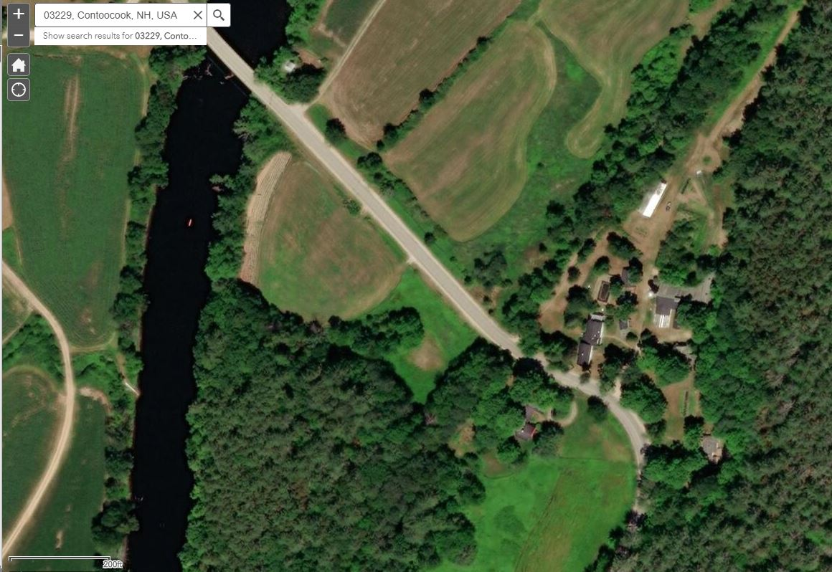
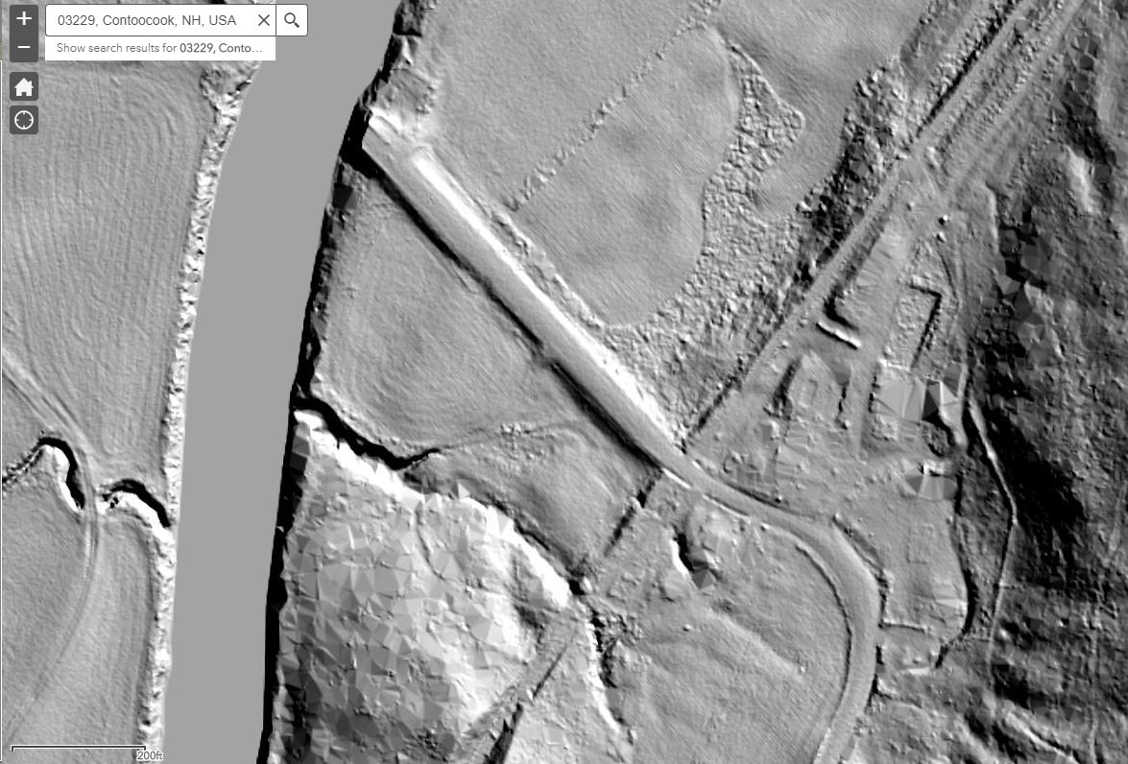
Stop #1 Tyler Station near 833 Penacook Rd.
Parking for Stop #1 is on Penacook Rd. between Tyler Bridge and 833 Penacook Rd. We suggest you park along the fields below the sharp curve. Please be respectful of private property. If you are driving, pull off the road completely and do not block driveways or roads. If you get out of your car, make sure you have the owner’s permission to be on it.
Little evidence of Tyler Station remains today.
The two maps on this page are from the website New Hampshire Stone Wall Mapper, an interface based on LiDAR (light detection and ranging) visualizations of the NH landscape that enables interested individuals to identify and map stone walls. We’ve used it here to help identify the old railroad bed that used to cross Penacook Road near Tyler Bridge.
The top map is a bird’s eye view of the Tyler District. The Contoocook River runs from the top to the bottom of the image, and you can see Penacook Road going from NW to SE in the top photo.
The bottom image, using LiDAR, also shows the river and Penacook Road, but what is also visible under the vegetation is the old railroad bed running from NE to SW.
For more information on the New Hampshire Stone Wall Mapper, click here.
Hopkinton Historical Society Celebrating Hopkinton History Since 1859

Slide 7
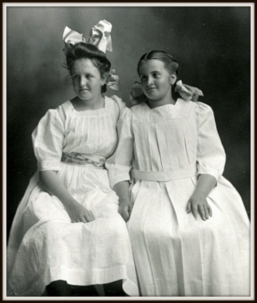
Stop #1 Dorothy Brockway Osborne near 833 Penacook Rd.
Parking for Stop #1 is on Penacook Rd. between Tyler Bridge and 833 Penacook Rd. We suggest you park along the fields below the sharp curve. Please be respectful of private property. If you are driving, pull off the road completely and do not block driveways or roads. If you get out of your car, make sure you have the owner’s permission to be on it.
As an adult, Dorothy Brockway Osborne (1898-2001) remembered fondly her childhood visits to her grandparents’ home in Hopkinton. She would come for summers as a young girl with her older sister Marion (1896-1976), often taking the train to Tyler Station. Her grandparents, Amanda Carroll and John Griffin Brockway, were living on Penacook Road, having moved from the family farm on Brockway Road. It was the early 1900s, and the Brockway family was three generations deep in Hopkinton history.
Dorothy’s great grandfather, John Brockway (1793-1874), had purchased a farm consisting of 156 acres from Aaron Smith in 1860. The hope of John Brockway was that the farm would remain in the family for generations, as was stated in his will. It remained in the family when bequeathed to his son John Griffin Brockway (1834-1914). It was there that the extended family had summer “picnics” at the homestead. Many photographs survive the years showing groups in wagons, near barns, among farm animals.
But the farming way of life was not to extend another generation as Frederick John Brockway (1860-1901), John Griffin’s son, chose a career in medicine – becoming an outstanding doctor specializing in surgery and a medical professor at Columbia University. Frederick married Marion Turner and together had daughters, Marion and Dorothy. Frederick’s father, recognizing the large farm was no longer an asset, sold it and moved to a smaller farm on Penacook Road. By the time Dorothy and her sister could remember their summer visits to Hopkinton, their father had died and their mother was raising her daughters in New York City.
The memories of visiting the grandparents were so pleasing to Dorothy, she retired to the area and became active in many organizations including the Hopkinton Historical Society, Hopkinton Town Library and the New Hampshire Audubon Society which manages the John Brockway Nature Preserve on land kept in the family since 1860.
Photograph of sisters Marion and Dorothy Brockway, who travelled each summer by railroad to Tyler Station to stay with their paternal grandparents. HHS collection.
Hopkinton Historical Society Celebrating Hopkinton History Since 1859

Slide 8
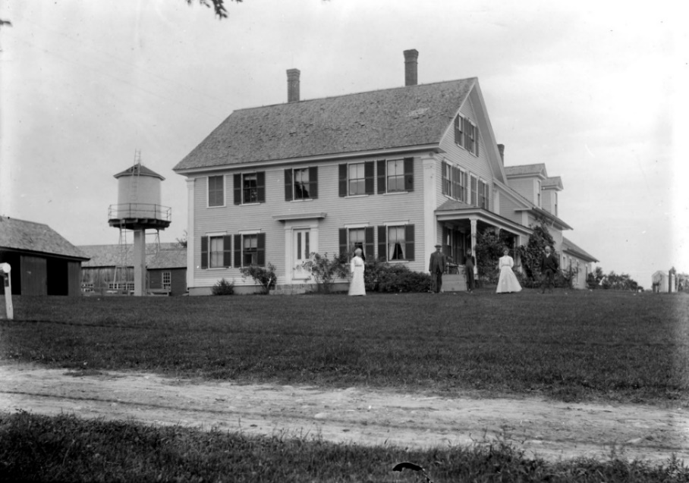
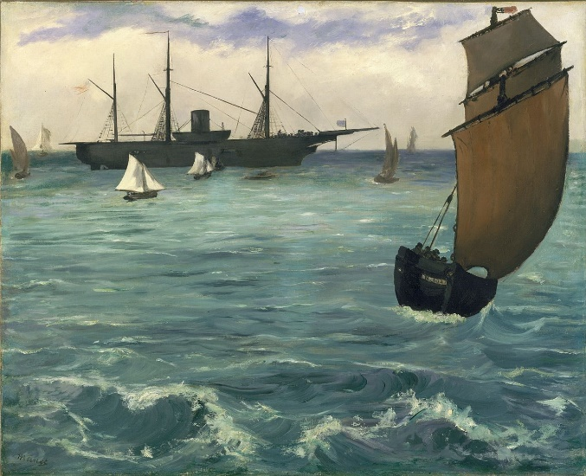
Stop #2 Joseph Barnard Home 1030 Briar Hill Rd.
This is a private home and we ask that you remain in your car. Please pull off the road completely and do not block driveways or roads.
Joseph Barnard (1817-1899) was a lumberman with numerous wood lots (oak and pine) in the northeastern quadrant of Hopkinton at the time the railroad was coming to Hopkinton. One source says, “he became interested in the Boston and Maine Railroad and negotiated the deal whereby he furnished all the lumber for the railroad tracks when the railroad was put through from Concord to Warner.” He was also one of the original incorporators of the Contoocook Valley Railroad in 1849. Much of the family property went from Broad Cove Rd. north toward the town border with Webster.
Barnard had lived most all his life in Hopkinton at the family homestead on Briar Hill Road. Besides the lumber industry (he would also provide lumber for ships used during the Civil War, including the USS Kearsarge), Barnard was a prominent dairyman and farmer, winning awards for Guernsey cattle and for fruit production. He was the 3rd generation of Joseph Barnards in Hopkinton; his grandfather also named Joseph Barnard (1737-1815) came from Amesbury, Massachusetts, in the 1760s. A descendant wrote about this ancestor, he
“was somewhat assisted by slave labor, as is clearly shown by the copy of a deed now in the possession of Joseph Barnard (the grandson), it being a bill of sale, dated March 29, 1777, given him by Ruth Currier, of Kingston, NH, conveying unto him a negro man named Seeko. Mr. Barnard has likewise the indenture of a boy of 13, dated in 1769. This deed of sale proves conclusively that slavery once existed in the old Granite State, although the contrary has been persistently asserted by some high in authority.“
The next two pages of this presentation contain a fuller biography of Joseph Barnard.
Seeko Barnard’s story – including service in the American Revolution – is explored in the Hopkinton Historical Society’s 2019 Putney Hill Cemetery Walk which constructs an inclusive multi-vocal narrative of Hopkinton past and present, and is a recent recipient of a national “Leadership in History” award from the American Association of State and Local History. Copies of the Cemetery Walk are available for purchase at the Society.
Photograph of Joseph Barnard’s home, located at 1030 Briar Hill Rd. HHS collection.
The Kearsarge at Boulogne is an 1864 painting by Édouard Manet depicting the Union cruiser USS Kearsarge, victor of the Battle of Cherbourg over the rebel privateer CSS Alabama. The painting is owned by the Metropolitan Museum of Art. The USS Kearsarge was built with lumber supplied by Joseph Barnard.
Hopkinton Historical Society Celebrating Hopkinton History Since 1859

Slide 9
Stop #2 Joseph Barnard Home 1030 Briar Hill Rd.
This is a private home and we ask that you remain in your car. Please pull off the road completely and do not block driveways or roads.
Biography of Joseph Barnard
Source: Barnard, Jared Alan. Joseph Barnard, Access Genealogy. Accessed July 3rd 2020. https://accessgenealogy.com/new-hampshire/biography-of-joseph-barnard.htm.
Joseph Barnard, third, a prominent agriculturalist, horticulturalist, stock-grower, and lumberman, of Hopkinton, Merrimack County, N.H., was born November 11, 1817, on the farm that he now owns and occupies, he being the third of the name to hold a title to it. His grandfather, Joseph Barnard, the first of the name, so far as known, a native of Amesbury, Mass., coming to New Hampshire in 1765 or 1766, purchased land in the south-east part of Hopkinton. The land was bought of the Rev. James Scales, the first settled minister in Hopkinton, it having been granted to him by the original proprietors, John Jones and others. Grandfather Barnard lost his title to that land, as others did of their lands in the vicinity, by the claims of the “Bow Company,” so called, and was given in exchange by the proprietors the land, previously unallotted, on which he established his home, and which is now occupied by his grandson and namesake, as mentioned above. It may be added as a part of this historical reminiscence that some land in the north-west part of the town of Hopkinton, north of the Contoocook River, was laid out in lots and sold at auction, to pay the expenses of the controversy with the Bow Company, the price received from the buyers, who were the Whites of Portsmouth, being ten cents an acre.
The Barnards of Hopkinton are probably descendants of Thomas Barnard, an early settler of Salisbury, Mass., who was one of the first Selectmen of that part of the old town that in 1668 was incorporated as Amesbury. Among his children were, it is said, a son Thomas, born in 1641, and Nathaniel, born in 1643. A Nathaniel Barnard, of Amesbury, evidently of a later generation, married Ruth French, of Kingston, N.H., and was the father of twelve children, including sons Joseph, Thomas, and Tristram, and a daughter, Mebitable (sic), who married a Currier, and lived to be one hundred and three years old.
Joseph Barnard, first, son of Nathaniel and Ruth, was born in Amesbury, Mass., January 12, 1737. In 1766 he removed to Hopkinton, as stated above, and, establishing a home there, worked as a farmer and ship-carpenter until his death, November 13, 1815. His first wife, Rhoda Currier Barnard, whom he married in Amesbury, died on April 7, 1794, leaving one daughter, Rhoda Currier, who married Ezra Morrill, of Hopkinton, and lived to the venerable age of ninety-three years. Joseph Barnard, first, married for his second wife Mrs. Olive Blake Hale, widow of Captain John Hale, an officer in the Revolutionary War. They had two children, Joseph, second, born May 6, 1795; and Sarah Ann, born April 12, 1798. Sarah Ann Barnard became the wife of Joshua Pierce, of Warner, but spent her last years in Manchester, N.H., where her death occurred August 22, 1869.
Joseph Barnard, second, father of the present Joseph, the special subject of this biographical sketch, was born, lived, and died on the old home farm, the date of his death being March 15, 1870. He did his full share of the pioneer work begun by his father, adding to the improvements already made on the original purchase of one hundred and fifty acres, clearing, fencing, and draining a large part of it. His father was somewhat assisted by slave labor, as is clearly shown by the copy of a deed now in the possession of Joseph Barnard, third, it being a bill of sale, dated March 29, 1777, given him by Ruth Currier, of Kingston, N.H., conveying unto him a negro man named Seeko. Mr. Barnard has likewise the indenture of a boy of thirteen years old, dated in 1769. This deed of sale proves conclusively that slavery once existed in the old cont’d on next page
Hopkinton Historical Society Celebrating Hopkinton History Since 1859

Slide 10
Stop #2 Joseph Barnard Home 1030 Briar Hill Rd.
This is a private home and we ask that you remain in your car. Please pull off the road completely and do not block driveways or roads.
cont’d from previous page
Granite State, although the contrary has been persistently asserted by some high in authority. Joseph Barnard, second, was a man of far more than ordinary business ability. He invested largely in realty, and at his death owned several thousand acres in various townships, mostly timbered land, valued at seventy-five thousand dollars, one tract alone in Boscawen being appraised at fifty-two thousand dollars, while his entire estate amounted to about eighty thousand dollars. Naturally progressive, being quick to perceive the merits of anything new, he was the first to introduce Merino Sheep and also Saxony sheep into the town; and in 1838 he received the first prize for the finest exhibit of wool in New York.
In June 1816, Joseph Barnard, second, married Miriam J. Eastman, who was born on Horse Hill, Concord, N.H., December 6, 1799, a daughter of William Eastman, a Revolutionary soldier. They reared the following children: Joseph, third, whose name appears at the head of this sketch; Sally Ann born April 3, 1819, who is now the widow of Daniel P. Dustin, late of Contoocook; Mary Jane, born August 29, 1821, now the wife of Charles N. Tuttle, of Contoocook; William E., born May 27, 1823, who died at Edgerton, Ohio, April 2, 1884; and Rhoda Currier, born February 19, 1827, who married Dr. Ephraim Wilson, and died August 4, 1852. Mrs. Miriam J Eastman Barnard died September 17, 1869.
Joseph Barnard, third, remained with his parents until twenty-two years old, the last part of the time receiving ten dollars a month for his work on the farm; and while still in his minority he served four years as Quartermaster in the Old Fortieth New Hampshire Regiment. After leaving home he spent two years as clerk in a store at Contoocook, and then went to Lowell, Mass., where he learned the stone-cutter’s trade, working at first for one dollar and a half per day, and boarding President Tyler, it will be remembered, made a tour of the Lowell mills and factories, interesting himself in the industries of the city; and on the second day of his stay, after large parades of civil and military companies, and ten thousand patriot girls dressed in white, he made and excellent speech of two hours’ duration, in which he acknowledged the benefits of the tariff. In the following session of Congress, it may be added, he signed the tariff bill. The epidemic which broke out two weeks after his visit in Lowell was given his name.
While recuperating, Mr. Barnard returned to his boyhood home; and when there he purchased from his father a tract of timber land for eight hundred dollars, buying it, however, in opposition to his father’s advice. Establishing himself then in the lumber business, he carried it on for thirty-five years, meeting with good success from the start. He supplied timber of all kinds for use in ship-building, his operations extending over several townships, in which he erected or hired mills, employing at different times forty men. The tallest mast timber in the State is found in the valleys of the Contoocook, Blackwater, and Warner Rivers, the regions in which he carried on his lumbering. During the late Rebellion he furnished much of the timber for naval supplies, and all the large timbers of “Ironsides,” and most of the material for the “Kearsarge”, which has recently been destroyed. In the Granite Monthly of May, 1893, is an article written by Mr. Barnard concerning the “Timbers of the Kearsarge,” in which it is stated that Mr. Barnard and the Hon. J.H. Butler, of Nottingham, were associated in 1860 in
cont’d on next page
Hopkinton Historical Society Celebrating Hopkinton History Since 1859

Slide 11
Stop #2 Joseph Barnard Home 1030 Briar Hill Rd.
This is a private home and we ask that you remain in your car. Please pull off the road completely and do not block driveways or roads.
cont’d from previous page
Newburyport, Mass., in handling oak timber for ship-building, and in 1861 were called upon to furnish timber for gunboats, said timber to be of first quality. White oak is in its best state when from eighty-five to one hundred years old; and this they found in large quantities on a hill near Tyler Station in Hopkinton, N.H.; and soon had a large force of men at work getting out white oak and yellow pine, sending to the Portsmouth Navy Yard a large part of the white oak of seven hundred and fifty thousand feet of timber for the building of the famous boat the received its name from the Kearsarge Mountain, which stands in plain view of the spot whereon its timbers were hewed.
Mr. Barnard resided in Contoocook twenty-five years of this time, and while there built in 1849 the Contoocook Valley Railway, extending from Contoocook to Hillsborough, fourteen and one-half miles, he being superintendent of construction, and furnishing much of the timber used. For several years he was officially connected with the road. He has also been Fire Claim Adjuster of the Concord Division of the Boston & Maine Railway for some years, an office that takes him quite often over the two hundred miles under his charge. Four years after the death of his father Mr. Barnard removed to the parental homestead, which he inherited; and he has since devoted much of his time to farming pursuits. He settled this estate, and has also settled many others in Merrimack County, usually by request, sometimes on commissions to appraise for tax purposes; and he is often called upon to estimate the timber on large tracts of land. For several years Mr. Barnard had charge of the waterpower at Contoocook; and in 1870 and 1871 he represented that town in the State legislature, where he was one of the Committee on Towns and Parishes, 1889. At the time of the war for the Union he was the enrolling officer in the Twentieth District, and the mainstay of the widows and fatherless, who trusted him implicitly, and whose confidence was not misplaced.
As a stock-raiser and dairyman Mr. Barnard breeds the Guernsey Cattle, which he exhibits at the various fairs in this section of the State, invariably securing prizes, both on cattle and dairy products. It was largely through the exhibitions of stock that he has made that the Deerfoot Creamery was located at Contoocook, and his herd of Guernsey has stocked many of the large New England dairy farms. In the culture of fruit of all kinds he takes great interest; and at a horticultural fair in Concord, when over a hundred exhibits were entered, he took thirteen prizes and sweepstakes for the finest fruits. He is a member of various agricultural and horticultural societies and a contributor to many of the journals. In politics he was in early manhood a Democrat, and voted for Franklin Pierce for President, but since that time has supported the principles of the Republican party.
On October 26, 1849, Mr. Barnard married Maria Gerrish, who was born April 15, 1831, a daughter of Abiel and Eliza (Dodge) Gerrish. Her father was born on the present site of the county farm in Boscawen, and her mother in that part of Merrimack County now included in the town of Webster. Mr. and Mrs. Barnard are the parents of eight children, the following being their record: Ellen Maria born March 1, 1851, died January 6, 1886; Joseph Henry, born October 12, 1852, died July 9, 1855; Abiel Gerrish, born January 8, 1855, was a lawyer in California; Joseph B., born March 17, 1857, died October 23, 1863; Mary Eliza, born January 11, 1859, is the wife of Jonathan Fowler, of South Sioux City, Neb.; George Edgar, born November 1, 1864, married Miss Bertha S. Tyler of Hopkinton, and now carries on the home farm; Rhoda Frances was born June 28, 1867; and Charles Lewis, born March 28, 1870, died December 29, 1895.
Hopkinton Historical Society Celebrating Hopkinton History Since 1859

Slide 12
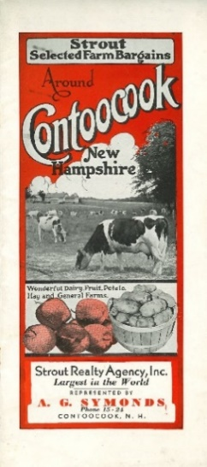
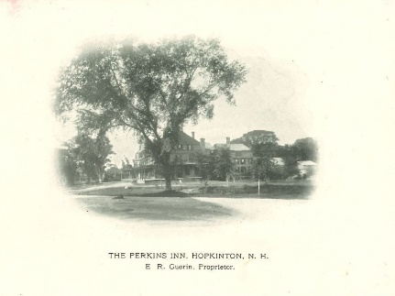
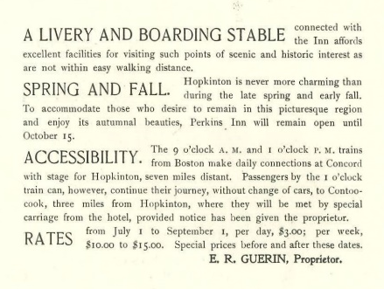
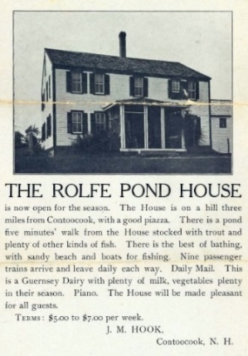
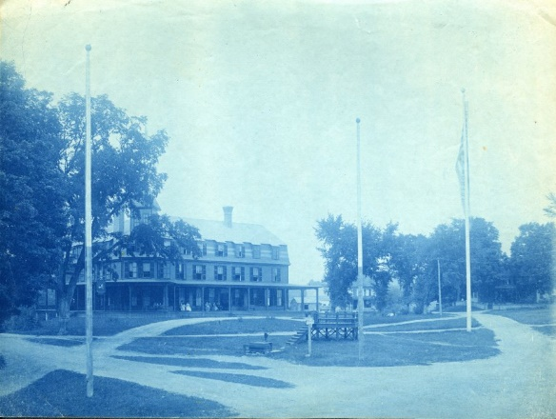
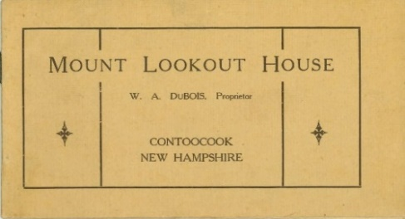
Stop #3 Inns, Summer Homes, and Camps 1548 Hopkinton Rd.
Advertisements for various inns and a real estate brochure located in Hopkinton, all circa early 1900s. HHS collection.
Parking for Stop #3 is at the First Congregational Church of Hopkinton. From here you can see the Civil War Monument, which is where the Perkins Inn stood.
In the mid-1880s the value of Hopkinton's beautiful location began to be recognized. Taverns became summer boarding houses, grand homes were bought as summer residences or leased to summer visitors, and farm houses took in boarders for periods of days, weeks or months. The trains helped make the appealing lifestyle of the small town accessible to city dwellers.
One such hotel was the Perkins Inn, located on the Village Green of Hopkinton Village (cyanotype of Perkins Inn below). Its advertising highlighted the easy accessibility by rail, as did other inns in town. Unfortunately, the Perkins Inn was leveled by fire in 1907.
Hopkinton Historical Society Celebrating Hopkinton History Since 1859

Slide 13
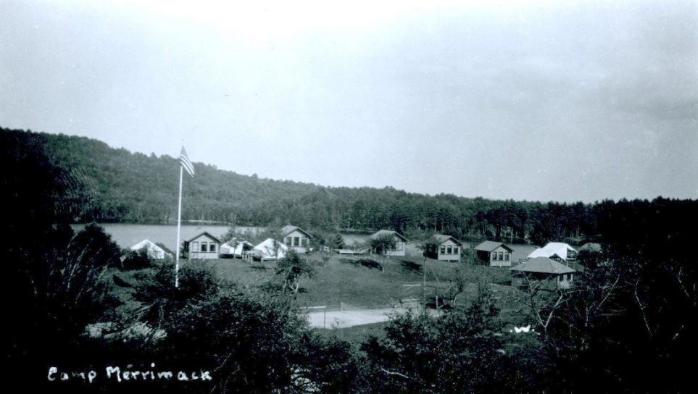
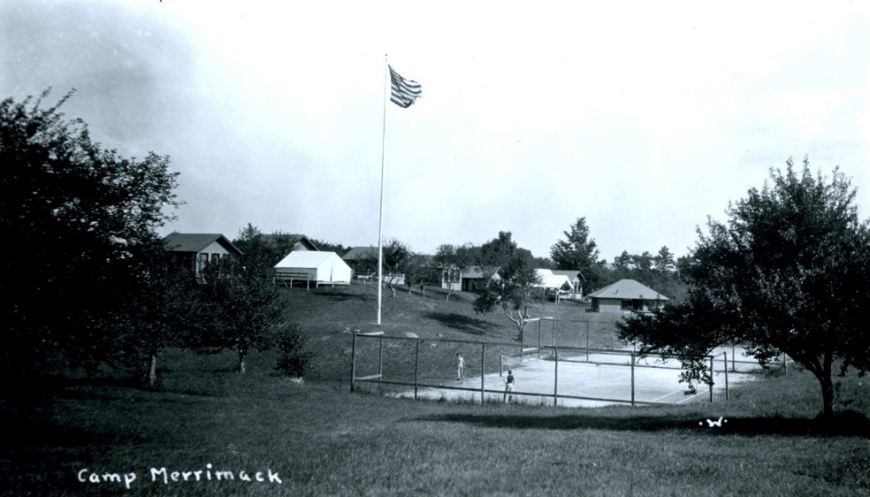
Stop #3 Inns, Summer Homes, and Camps 1548 Hopkinton Rd.
Parking for Stop #3 is at the First Congregational Church of Hopkinton. From here you can see the Civil War Monument, which is where the Perkins Inn stood.
Although Camp Merrimack was located in West Hopkinton, in the interest of grouping similar subjects, we are including Camp Merrimack as part of Stop #3.
Camp Merrimack, located in the area formerly known as Cloughville, was established as a summer camp for Jewish boys in the early 20th century. It changed ownership in the mid-1950s and operated for a number of years as a general summer camp. Today the property is owned by the Greek Orthodox Metropolis of Boston and is operated as a year-round camp and retreat center.
Ken Smart of Hopkinton, who worked for the railroad from 1947-1952, remembers the hectic summer months at the Contoocook Freight House:
The summer months were the busiest as we dealt with the coming and going of the campers of Camp Merrimack and the additional summer boarders that came to town by train. It seems like the freight house [located where TD Bank is today at 884 Main St, Contoocook, NH] would be filled with trunks and duffle bags that all had to be weighed and tagged around July 1 and again the end of August.
Postcard images of the cabins and tennis courts at Camp Merrimack located in West Hopkinton. HHS collection.
Hopkinton Historical Society Celebrating Hopkinton History Since 1859

Slide 14
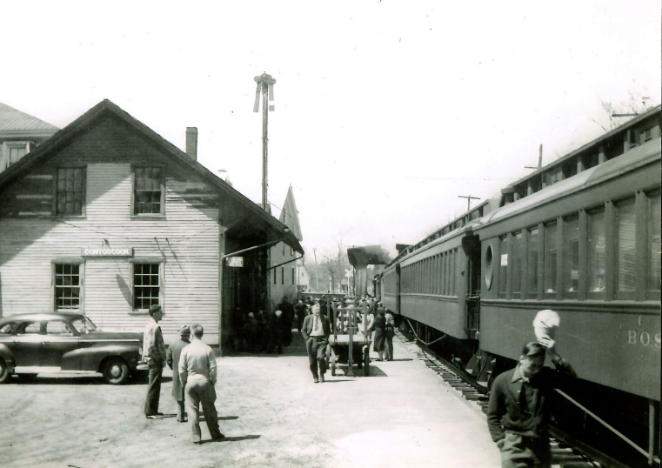
Stop #4a Contoocook Depot 896 Main St., Contoocook
For all of the Contoocook Village stops near the Depot (Stops 4a 4d), park in the Municipal Parking Lot beside the Contoocook Railroad Museum located at 896 Main St. If you’d like, you can get out of your car and explore the different stops in Contoocook Village on foot.
The Contoocook Railroad Depot was completed in 1849 as the first substantial railroad passenger station west of Concord on the Concord & Claremont Railroad (which later became the Boston & Maine Railroad in 1887). The building is one of the best preserved of a small number of gable-roofed railroad stations surviving from the first decade of rail development in New Hampshire. The station exemplifies the pioneering period of rail development in the state and is one of the earliest and least altered depots of the 1850 period. Displaying the Greek Revival style, with modifications that proclaim its identity as a new building type, the depot is an important artifact in the history and evolution of railroad architecture in New Hampshire.
At first, rail connections from Contoocook largely focused on Concord. Travelers going east from Contoocook were able to connect to the Concord Railroad, thereby gaining rail access to Manchester, Nashua, Lowell, and Boston; or to the Northern Railroad, providing access to all towns on the route from Concord to West Lebanon on the Connecticut River and to White River Junction, Vermont; or to the Boston, Concord, and Montreal Railroad, thereby gaining access to Woodsville on the Connecticut River and to Wells River, Vermont.
Trains traveling northwesterly on the Concord and Claremont Railroad's tracks were limited at first by the tracks' termination in Bradford, which was reached in July 1850. Not until the Newbury Cut was completed in 1871 were trains at last able to travel to Newport and finally, in 1872, to make contact with the Connecticut River at Claremont. Similarly, the Contoocook Valley Railroad, which connected with the Concord and Claremont in Contoocook, was initially completed only as far south as Hillsborough Bridge where it would connect with other railroad lines.
Passenger Train at the Contoocook Depot, circa 1940s. HHS collection.
Video of engine arriving in Contoocook through the covered bridge. Courtesy of Contoocook Riverway Association.
Hopkinton Historical Society Celebrating Hopkinton History Since 1859

Slide 15
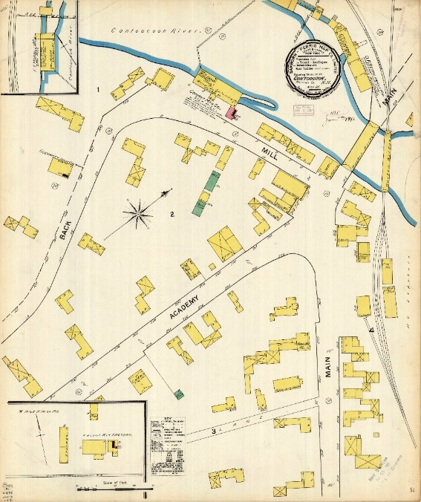
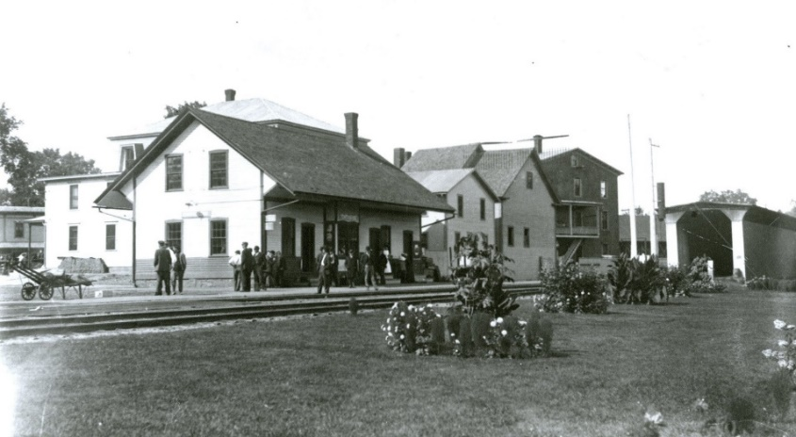
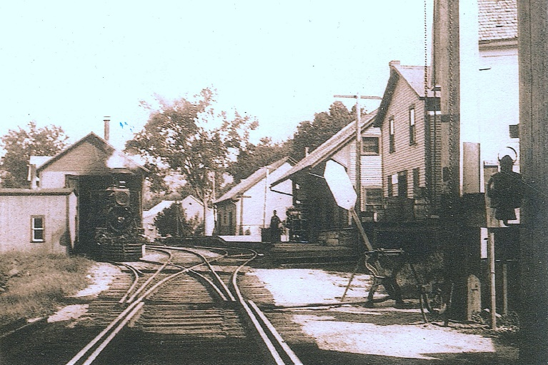
Stop #4a Contoocook Depot 896 Main St., Contoocook
For all of the Contoocook Village stops near the Depot (Stops 4a 4d), park in the Municipal Parking Lot beside the Contoocook Railroad Museum located at 896 Main St. If you’d like, you can get out of your car and explore the different stops in Contoocook Village on foot.
In the fall of 1849, when the first train travelled between Concord and Contoocook, a day of great festivity was held. Railroad officials extended free rides to and from the city of Concord, and a large celebration was held. A subscription had been raised, a public dinner provided, music and artillery secured, and about 1,000 people sat down to eat at the long tables that had been set up. Speeches were made, the band played, and the cannon thundered.
from Life & Times in Hopkinton by C.C. Lord
In 1884, the Contoocook rail center consisted of the following buildings: the depot and ell, freight house, engine house, water house, wood shed, three hand car houses, and rail shop. All of these structures, with the exception of the depot and freight house, had been removed by 1904. Since then, the freight house has also been removed. This 1892 Sanborn Insurance Map shows the location of these structures. Source: Dartmouth University Library.
Providing an enjoyable travelling experience for its passengers was important to the Boston & Maine Railroad, which sponsored flower competitions at depots. Shown here is a display of flowers at the Contoocook Depot. HHS collection.
This undated photograph shows the Depot on the right, in about the middle of the photo. Just beyond the Depot is the freight house. Photo courtesy of Dane Malcolm. HHS collection.
Hopkinton Historical Society Celebrating Hopkinton History Since 1859

Slide 16
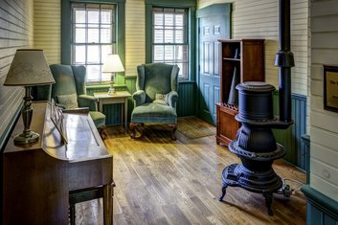
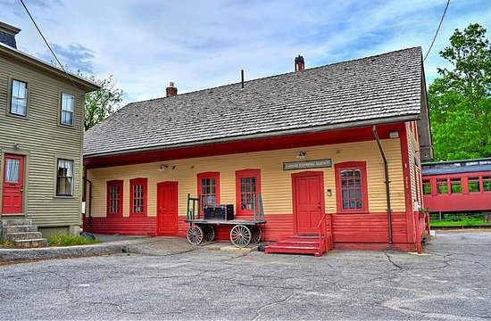
Stop #4a Contoocook Depot 896 Main St., Contoocook
For all of the Contoocook Village stops near the Depot (Stops 4a 4d), park in the Municipal Parking Lot beside the Contoocook Railroad Museum located at 896 Main St. If you’d like, you can get out of your car and explore the different stops in Contoocook Village on foot.
In the 1950s, as the era of railroad transportation in New Hampshire was waning, the Depot was purchased by Dodd Insurance Agency, which it shared with the railroad until 1956. That year auto-bus routes took over mail transportation, and passenger service from Contoocook to Concord was given up. In 1962, when the Hoague-Sprague mills in West Hopkinton converted from coal (delivered by rail from Claremont to West Hopkinton via Contoocook) to oil (delivered by truck), freight service was discontinued.
In 1999, the Depot was purchased by the Contoocook Riverway Association from the town of Hopkinton for one silver dollar and restoration began in 2002. The $400,000 restoration project was funded by federal grants community donations and took approximately three years to complete.
The depot's surviving interior details include two ticket windows and most of the original walls and ceilings, still covered with tongue-and-groove paneling common in the late 19th century. Over the years, many original items have been returned to the depot by the community such as the enameled blue "Contoocook" station sign, luggage cart, seating bench, and other irreplaceable items.
Go to Contoocook Railroad Museum for additional details about current and future restoration projects.
Images of the interior and exterior of the Contoocook Depot following restoration. Photos from the Contoocook Railroad Museum.
Hopkinton Historical Society Celebrating Hopkinton History Since 1859

Slide 17
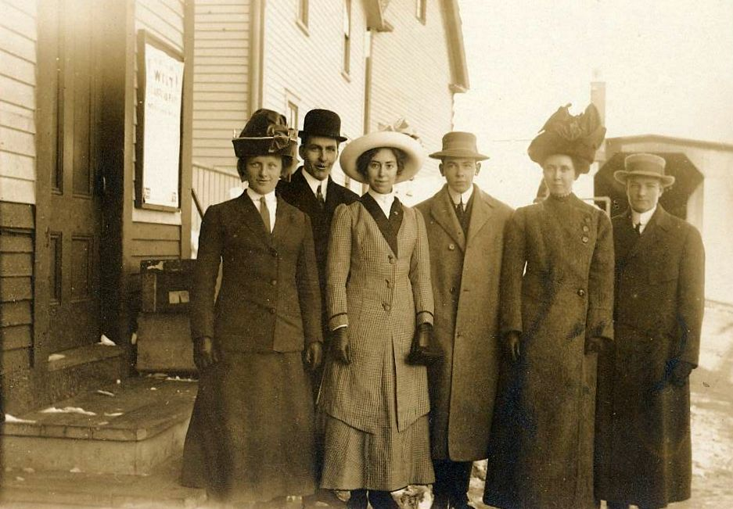
Stop #4a Contoocook Depot 896 Main St., Contoocook
For all of the Contoocook Village stops near the Depot (Stops 4a 4d), park in the Municipal Parking Lot beside the Contoocook Railroad Museum located at 896 Main St. If you’d like, you can get out of your car and explore the different stops in Contoocook Village on foot.
Lovely image of six young people at the Contoocook Depot with the covered railroad bridge visible on the right. Perhaps they were preparing to embark for a trip to the city?
Hand-written on the reverse
“Alice Fifield
Richard Clough
James Purrington
Allice True (I think)
Almond Corliss (I think)”
No indication is given as to the order of names or individuals. However, Allice Fifield, Richard Clough, and James Purrington were all 1912 graduates of Hopkinton High School, and the males served in WWI. Although the photo is not dated, it was likely taken sometime between graduation in 1912 and the U.S.’s entry into WWI in 1918. Gift of Kathleen Sorokin Little, HHS collection.
Hopkinton Historical Society Celebrating Hopkinton History Since 1859

Slide 18
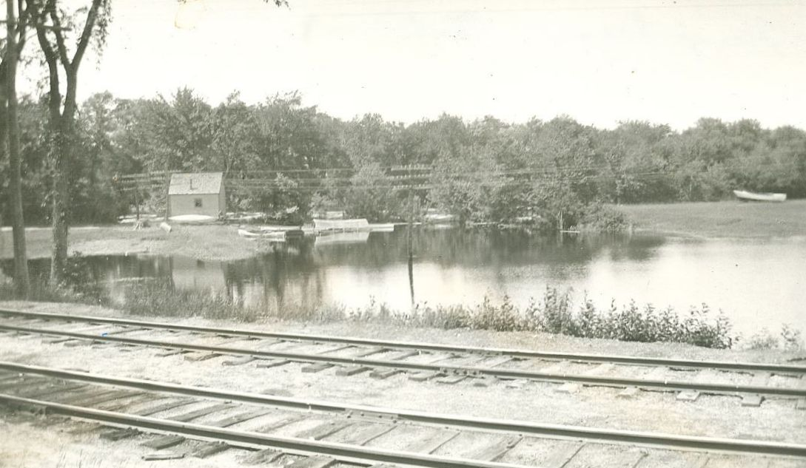
Stop #4b Contoocook Depot: Tramp House 896 Main St., Contoocook
For all of the Contoocook Village stops near the Depot (Stops 4a 4d), park in the Municipal Parking Lot beside the Contoocook Railroad Museum located at 896 Main St. If you’d like, you can get out of your car and explore the different stops in Contoocook Village on foot.
On March 12, 1878, Hopkinton voters authorized up to $200 to be spent on building two tramp houses, one in each village. The town report of 1879 indicates a prompt response with payments to various individuals for lumber, labor, nails, blacksmith work, bedding, and rent of land for “tramp’s house.” This expenditure was most likely in response to a large increase in numbers of itinerants occurring locally and nationwide, many being Civil War veterans who, for various reasons, found themselves unable or uninterested in returning to their previous homes and lifestyles. The nation’s economy was in shambles and many of these men were looking for some way to scratch out an existence. Many were rail-borne, some getting work building and maintaining the country’s ever-expanding system of railroads and others riding the rails to short-term jobs in fields and factories, near and far away. With each succeeding down-turn in the economy, the number of transients nationwide would temporarily increase, especially leading up to WWI and again during the Great Depression, at which time it is said that more than a million men, as well as women and children, became American hoboes.
Image of what is believed to be the Tramp House that was located near the Contoocook Depot. The tramp house was located where the Contoocook Riverway Park is located today. The shoreline in the image does not match up with the shoreline today due to changes in the flow of the Contoocook River following construction of the Hopkinton-Everett Dam. HHS collection.
“Tramps have been numerous here lately, five being entertained Sunday night and five on Monday. Three of them were arrested Tuesday for stealing a horse, but were released Wednesday morning on the arrival of the sheriffs from Hillsboro, the men proving not to be the parties wanted.”
Kearsarge Independent, January 3, 1908
Hopkinton Historical Society Celebrating Hopkinton History Since 1859

Slide 19
Stop #4b Contoocook Depot: Tramp House 896 Main St., Contoocook
For all of the Contoocook Village stops near the Depot (Stops 4a 4d), park in the Municipal Parking Lot beside the Contoocook Railroad Museum located at 896 Main St. If you’d like, you can get out of your car and explore the different stops in Contoocook Village on foot.
Most hoboes were honest people who simply wanted to find decent jobs. They gathered in camps known as “jungles,” usually located on the sunny side of hills for warmth, with trees and brush for shelter and a source of water for drinking, bathing, and washing their clothes, and within walking distance of railroad tracks. They often shared a meal, such as a “mulligan stew,” made by boiling water and adding scraps of meat and vegetables, each person contributing whatever he might have. Hoboes would always clean their camp area before moving on. They did not steal from each other, although gangs of robbers targeted hoboes on known pay days. Hoboes formed a loose brotherhood and developed a code of symbols, sometimes engraved on fence posts, to indicate matters of survival such as where food, meals, or a place to sleep might be offered, where work was available, where medical help might be found, and where dogs or police officers hung out.
As is human nature, the itinerants themselves developed a hierarchy with the label “hobo” indicating superiority, one who works hard and moves quickly, “tramp” meaning one who loafs and walks, and “bum” defining one who loafs and sits. It is certain that hoboes boarding a moving train (once it was out of the range of the railroad police) and riding it safely (sometimes lying on rods underneath a boxcar) demonstrated strength, skill, initiative, and resilience, traits that many employers might value highly. In fact, the hoboes among us have included such highly successful individuals as TV host Art Linkletter, oil tycoon H.L. Hunt, writer Carl Sandburg, and Supreme Court Justice William O. Douglas.
Here in Hopkinton, the two tramp houses offered itinerants shelter over many decades, with various repairs recorded as late as 1934. A town Tramp Department existed in the early 1900’s to assure help for tramps. The 1914 town report shows that Oscar N. Chase had been paid $45.00 for the care of 180 tramps and Frank H. Mills had been paid $40.25 for the care of 161 tramps. Taxpayers paid an additional $19.50 for wood and $4.00 for bedding while H. P Wilson was paid $2.00 for rent of the land for the tramp house. The 1915 town report included an article for the town meeting, “To see what action the town will take in relation to tramps, and pass any vote relating thereto.” The statistics recorded in that annual report included Oscar N. Chase being paid $87.50 for the care of 350 tramps and Frank H. Mills being paid $61.25 for the care of 245 tramps. Costs for wood, quilts, food, coffee, and rent had brought the Tramp Department expenditures to a total of $205.25. By 1918, the town report no longer showed a Tramp Department but rather oversight of tramps under the Police Department (with Oscar N. Chase and Frank H. Mills continuing to be involved). Starting in 1918, the town property list included “tramp house and cage” and these continue to be listed through the 1920’s; starting in 1930, more generic terms such as “town hall, lands, and buildings” replaced specific listings. After 1946, care of tramps is no longer mentioned in town reports.
cont’d on next page
Hopkinton Historical Society Celebrating Hopkinton History Since 1859

Slide 20
Stop #4b Contoocook Depot: Tramp House 896 Main St., Contoocook
For all of the Contoocook Village stops near the Depot (Stops 4a 4d), park in the Municipal Parking Lot beside the Contoocook Railroad Museum located at 896 Main St. If you’d like, you can get out of your car and explore the different stops in Contoocook Village on foot.
cont’d from previous page
Recently (March 11, 2020), Fritz Wetherbee on WMUR’s Chronicle, told about tramps and tramp houses in New Hampshire. Although tramps were prevalent in his childhood, Fritz said he hadn’t seen a tramp for about 60 years. Most of the tramps he knew had regular routes, passing through town at the same time each year; townspeople often looked forward to seeing them. Many New Hampshire towns once had tramp houses, but he knows of only three that remain standing, located in Richmond, Dunbarton, and Weare. Showing the small nicely repaired and restored one in Richmond, he reported that they usually contained a pallet to sleep on and a small woodstove, being a place to get out of the elements.
In speaking with current and recent residents of Hopkinton, only a few remember glimpses into this era of the town’s history. One recalls that her mother had told her to come right in from playing outside if a man looking a little different came around. Another remembers seeing tramps near the stream by his family home on Main Street but they didn’t approach and he didn’t fear them. A man who worked daily at the railroad station during his high school years (late 1940’s/early 1950’s) did not see any tramps riding the trains; a classmate who also worked occasionally at the station remembers seeing tramps in the area at times but they didn’t engage socially; he had been brought up to respect tramps and never thought ill of them. He also recalled a local resident who had once lived as a tramp and had written of his many fascinating adventures. Another man recalled that his mother would offer food and clothing to a few of the tramps and that the same tramps would return periodically; they were quiet, neither friendly nor frightening to him although he said that many townspeople were afraid of them. He also admitted to hitching a few rides on the rail himself as a youth, actually being given a hand to board by the conductor as the train slowed for Spring Street; he would go visit an aunt in Melvin Mills, or, with a buddy, enjoy a day in Warner, coming home by same day return train. Memories of life in Little Tooky in the 1940’s were shared by one of the ladies who lived there for many years. Although she questioned their wisdom, some of the women who lived by the River all summer, while their husbands worked out-of-state during weekdays, provided meals for some of the tramps coming into town. Perhaps if one searched the area even today, the code for “good for a handout” or “kind women” might be found with directional arrows faintly tooled on a fencepost near the location of the Contoocook tramp encampment.
Hopkinton Historical Society Celebrating Hopkinton History Since 1859

Slide 21
Stop #4b Contoocook Depot: Tramp House 896 Main St., Contoocook
For all of the Contoocook Village stops near the Depot (Stops 4a 4d), park in the Municipal Parking Lot beside the Contoocook Railroad Museum located at 896 Main St. If you’d like, you can get out of your car and explore the different stops in Contoocook Village on foot.
While it is unlikely that Joe Cornett spent any nights at the Tramp House in Contoocook, his story is included here as part of the larger story of increased transience during periods of economic downturn.
During the Great Depression, it is estimated that more than a quarter of a million teens left their homes in search of a job, a better life, and perhaps an adventure. Two such young men were Joe Cornett (1912-1996) and Howard Keats of Hopkinton. They decided to head to California when they were both about 18 years old. Joe ended up travelling for about six months before returning home to Hopkinton. His story is part of an oral history collection compiled by Craig Bohanan.
To learn more about teens riding the rails, go to https://erroluys.com/frontpage.html and https://www.pbs.org/wgbh/americanexperience/films/rails/#film_description.
“There was a kid named Howard Keats, 17 or 18 years old — around my age — lived down in Hopkinton on the main road towards Concord; wanted someone to go to California with him. He didn’t have much money and I didn’t either — had about $55.
We started in summertime. We took some food with us, we took blankets and we took junk. First day or two I thought: what the hell am I doing here? But about the third day we were sleeping on the side of the road and the sun came up and it was a lovely day and from then on in the trip was okay.
Near the Continental Divide the damn car broke down — we put a connecting rod through the crankcase. Anyway, we got this car all put back together and finally got to Venice, California where Howard’s mother was living. This was during the Depression so it was very difficult to get work. We’d mow lawns for a quarter and went up to Culver City to try to get work at Metro-Goldwyn; get work at a labor job. You had to have a hammer — you couldn’t get a job without a hammer. Had to have it for knocking sets apart or something. I never did get a job there.
Finally what happened was a kid named Johnny Krause who came from Sheboygan, Wisconsin — Johnny wanted to go home and it was suggested I go with him. Howard says: “I don’t think you ought to go, Joe.” But I decided to.
So we started out next morning bumming down the highway to Indio, California, a railroad town. We found the jungle, the hobo camp, and there were maybe 30 kids there. When a train comes by they say “everybody out!” and out we went. We got to a little town in Arizona called Maricopa and there they shook the train down — now shaking a train down is when the brakeman and the railroad dick go down the train and put all the bums off. By the time we got to Tucumcari there’s 29 of us traveling together. 29 of us slept on the jailhouse floor there. A thirtieth came in and had no place to lie down.
Then Johnny wants to go to Chicago to get to Sheboygan, but I want to stay south, because it’s getting cold. So I say goodbye to Johnny and get a train for St. Louis. The car I’m in is all lined with paper so I tear the paper down, wrap myself up in it to try to keep warm, because it’s November or December now, see. In St. Louis they had this place for homeless men called the Helping Mitt. You could go in there, get a bath, get your clothes deloused, see a doctor, get something to eat. You could stay 2-3 days, but I didn’t stay that long.
In East St. Louis around dusk I’m waiting for a train and a police car comes up and the policemen says: “What are you doing there?” I told him I was waiting for a train and he says: “Well, that’s a hell of a place to wait! They’ll kill you for the coat you got on. They shot a man right by that electric light pole a couple of nights ago. You better come up to the station.” Next day I say to myself: I think I’ll try the highway.
I finally got to Indianapolis, then Dayton, and into Wheeling, West Virginia. I went to Harrisburg then across the Hudson and up to Port Jarvis. I went in a diner there. They invite me into the back room and it’s a speakeasy! Place is loaded with guys. This kid takes a suitcase, fills it with bottles of booze, opens a drawer, takes out a revolver and starts filling it with shells. They’re going to run booze into New York along the same route Legs Diamond took before he was shot.
Finally I get into Boston. It was snowing and I had no rubbers and my feet were wet and cold and I got a ride to Lowell. I didn’t want to buy a railroad ticket, but I went down to the station and asked the man what it would cost to get to Concord. He told me and I got enough money — I got 19 cents left over! So I bought the ticket and got into Concord. Rafa Story was there and by Christ he gave me a ride home!”
Joe Cornett, in an oral history by Craig Bohanan
Hopkinton Historical Society Celebrating Hopkinton History Since 1859

Slide 22
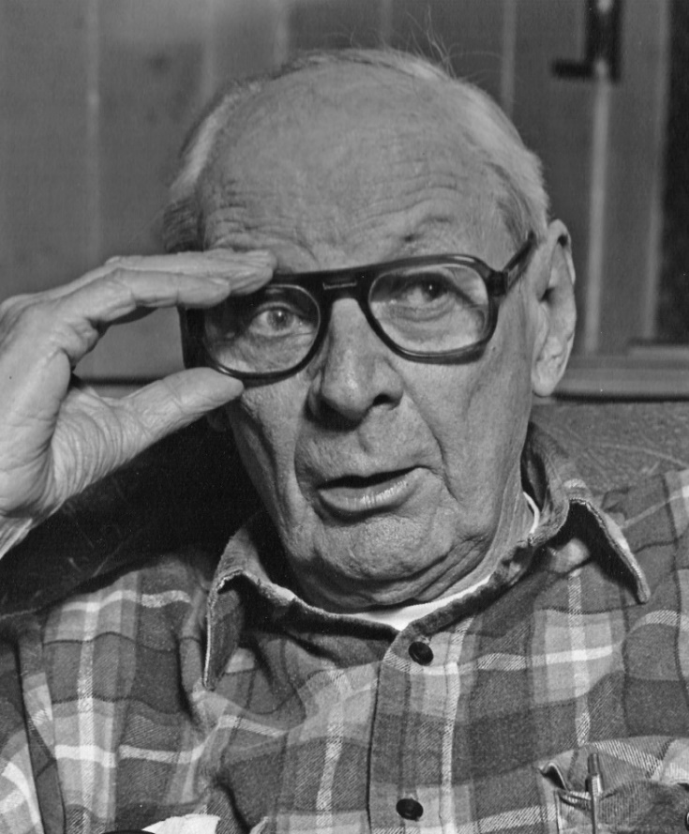
Stop #4b Contoocook Depot: Tramp House 896 Main St., Contoocook
For all of the Contoocook Village stops near the Depot (Stops 4a 4d), park in the Municipal Parking Lot beside the Contoocook Railroad Museum located at 896 Main St. If you’d like, you can get out of your car and explore the different stops in Contoocook Village on foot.
Hopkinton resident Dan Dustin graciously recorded three segments about Joe Cornett. In "Prelude," he describes his friendship with Joe Cornett and Craig Bohanan; in "Joe Cornett," Dan reads the oral history compiled by Craig Bohanan; and in "Postlude," Dan reflects on hitchhiking and the gift of small towns.
Photo credit Craig Bohanan
Prelude
Joe Cornett
Postlude
Hopkinton Historical Society Celebrating Hopkinton History Since 1859

Slide 23
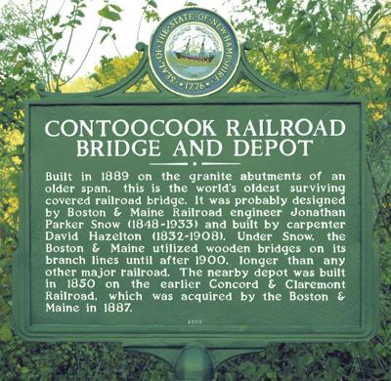
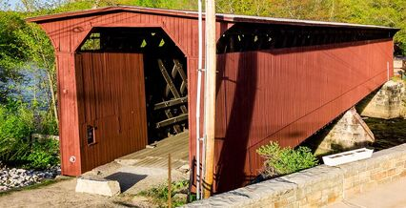
Stop #4c Contoocook Depot: Covered Railroad Bridge 896 Main St., Contoocook
For all of the Contoocook Village stops near the Depot (Stops 4a 4d), park in the Municipal Parking Lot beside the Contoocook Railroad Museum located at 896 Main St. If you’d like, you can get out of your car and explore the different stops in Contoocook Village on foot.
This clip shows trains going through the Contoocook Covered Railroad Bridge. Courtesy of Charles Fenton and the Contoocook Riverway Association.
Photo credit Bob LaPree.
The Contoocook Covered Railroad Bridge is the oldest covered railroad bridge in the U.S. that is still standing. It was rebuilt in 1889 to replace a lighter covered railroad bridge constructed between 1849–50, having been built by the former Concord & Claremont Railroad (acquired by the Boston & Maine Railroad in 1887). It is the oldest of four surviving double-web Town lattice railroad bridges. It was likely designed by Boston & Maine Railroad engineer Jonathan Parker Snow (1848–1933) and built by carpenter David Hazelton (1832–1908). Under Snow, the Boston & Maine utilized wooden bridges on its branch lines longer than any other major railroad, the last of these constructed in 1916.
The bridge was in use as a railroad bridge until 1962. It survived a flood in 1936, and the 1938 Hurricane. Both times it was moved off its foundations and saved from being completely washed down river by the rail tracks running through it.
Hopkinton Historical Society Celebrating Hopkinton History Since 1859

Slide 24
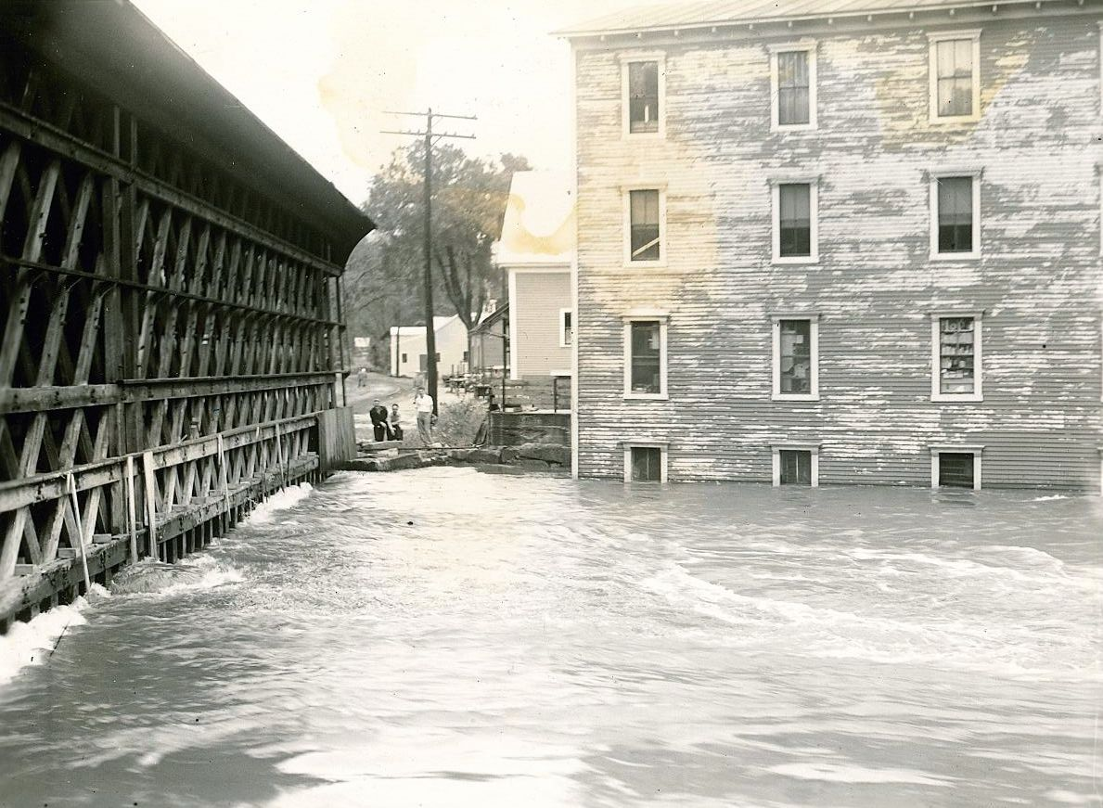
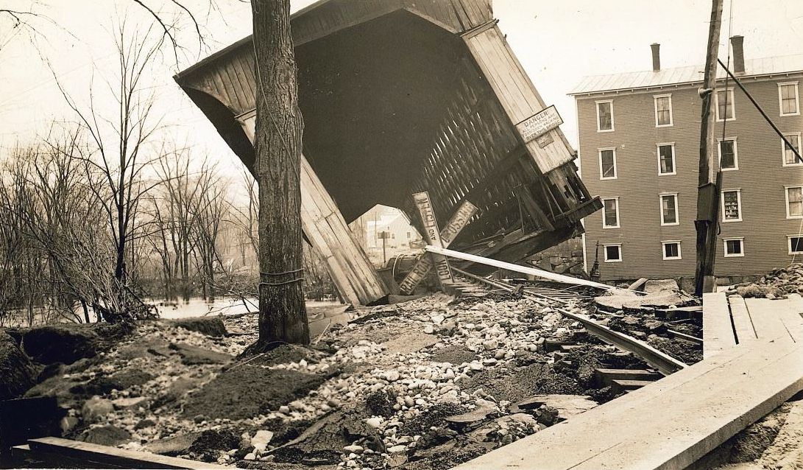
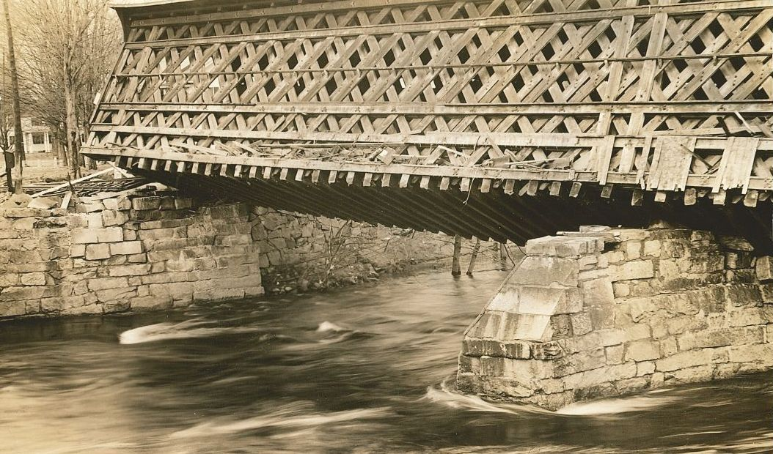
Stop #4c Contoocook Depot: Covered Railroad Bridge 896 Main St., Contoocook
For Stops 5a-5d, park in the Municipal Parking Lot adjacent to 44 Cedar St. If you’d like, you can get out of your car and explore the different stops in Contoocook Village on foot.
Images of the covered railroad bridge in Contoocook during high waters and after it was tipped during the 1938 hurricane. HHS collection.
High water was often an issue for the Contoocook Covered Railroad Bridge. During the flood of 1936 and the hurricane of 1938, the bridge suffered extensive damage. In fact, the only thing that prevented the bridge from being carried downriver was the strength of the steel railroad tracks.
Following the 1936 flood, the Claremont and Hillsboro Railway lines suffered so much damage that there was talk of discontinuing them. Claremont, however, had just finished paying franchise and demanded that the washed-out bridges, including the damaged bridge at Contoocook, be restored.
Following damage from the 1938 hurricane, trains from West Henniker to Hillsboro were given up.
Hopkinton Historical Society Celebrating Hopkinton History Since 1859

Slide 25
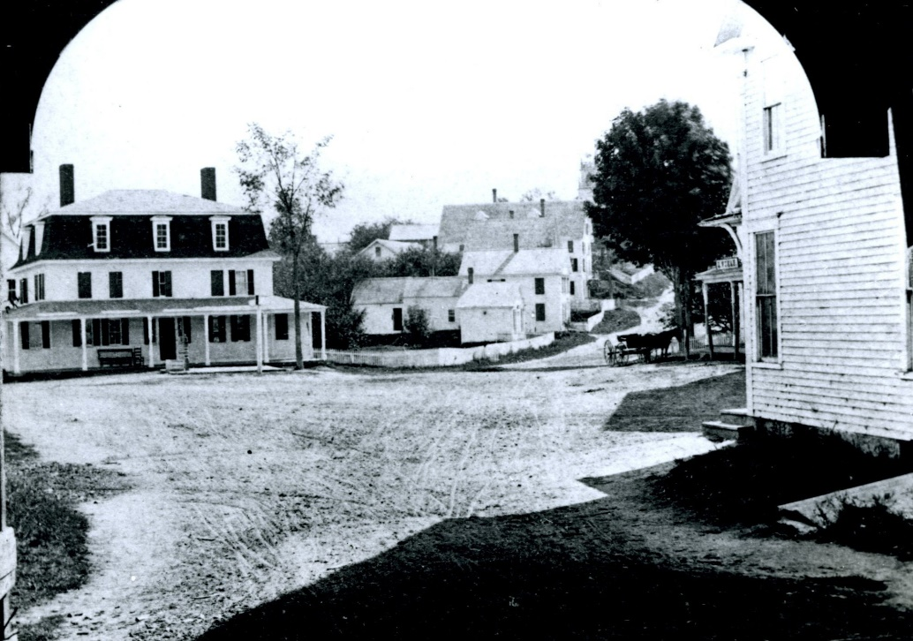
Stop #4d Railroad Workers: Who built Hopkinton’s Railroads? 896 Main St., Contoocook
For all of the Contoocook Village stops near the Depot (Stops 4a 4d), park in the Municipal Parking Lot beside the Contoocook Railroad Museum located at 896 Main St. If you’d like, you can get out of your car and explore the different stops in Contoocook Village on foot.
Here’s an interesting piece of Contoocook history. Where Mr. Mike’s gas station is now located, once stood a boarding house, called Old Central House. It would later be moved across the street, and for many years would be the Grange Hall and later the Boys & Girls Club. But when it was a boarding house, right across from the train station, there resided a group of Irishmen, who helped build Contoocook’s railroads.
Notes from Contoocook Grange (Hopkinton Historical Society 2014.17.24): “The home of Mrs. Edith Krzyzaniak and our grange hall was situated in Contoocook Square where the Esso station and Johnson Insurance Stands. It was built in 1831 and owned by Nathaniel G. H. Morrill. It was called Old Central House. A family of Blodgett and Walcott ran the Central House …. Young Irish men from Ireland boarded there and were Railroad laborers.”
In 1850, the census shows that the band of young Irish men were doing the same work on the Railroad in Bradford, also staying at a boarding house by the railroad. We presume that it was the same group of Irish laborers, following the work further down the line. Several people suggest that many young Irish men came to New Hampshire (and elsewhere) in the late 1840s due to the potato famine in Ireland. Many served as laborers on New Hampshire’s railroads.
Seen here through the covered highway bridge (which was replaced with the stone highway bridge in 1935), is the Old Central House, a boarding house where a group of Irishmen who helped build Contoocook’s railroads boarded. Today it is the site of Mr. Mike’s gas station. HHS collection.
Hopkinton Historical Society Celebrating Hopkinton History Since 1859

Slide 26
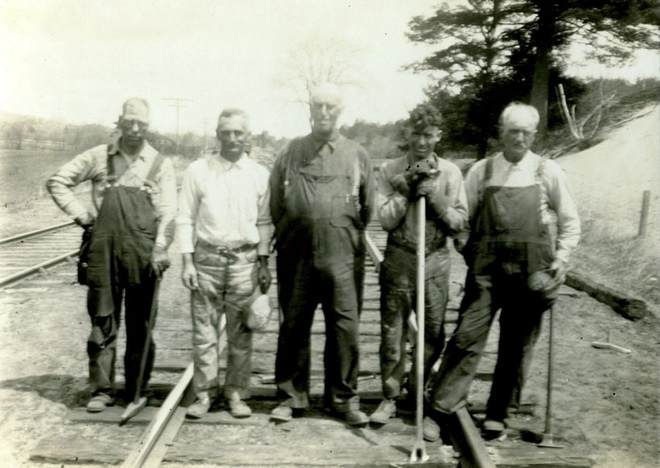
Stop #4d Railroad Workers: Snapshot from the 1910 Census 896 Main St., Contoocook
For all of the Contoocook Village stops near the Depot (Stops 4a 4d), park in the Municipal Parking Lot beside the Contoocook Railroad Museum located at 896 Main St. If you’d like, you can get out of your car and explore the different stops in Contoocook Village on foot.
Laborer: George Sweatt (1850-1927), the laborer, could have been a general laborer in one or more departments, possibly "Bridge and Buildings,” where he might have been an apprentice or just "muscle" at the bottom of the pay scale.
Section Hands: George W. Bailey (1872-1948), James W. Ripley (1849-1930), Fred True (1866-1935), and Benjamin H. Bartlett (1888-1960) were responsible for the care of the track and right-of-way for a section of the railroad, usually from two to eight miles.
Fireman: Bert Geer (1888-1976) was most likely a locomotive fireman, subordinate to the engineer on a locomotive and responsible for care of the boiler, maintaining boiler pressure (essential to getting the required amount of power from it), and general assistance in operating the locomotive. He kept it fed with coal fuel and filled with the proper amount of water from the "tender" (the small car behind the locomotive). He would have been responsible for filling the tender with fuel and water when necessary.
Station Agent & Telegraph Operator: The roles of Forrest Gillingham (1874-1953) and Ernest McLam (1877-1952) were somewhat interchangeable. Operators were essentially for control of traffic (telegraphy and signaling) under the direction of the dispatcher, whereas agents may have those duties and also station duties such as ticket sales, processing of packages and local freight shipments, mail handling, etc.
Section Foreman: Edward Sweatt (1866-1935) would have been the boss of a section gang.
Section gang photo. One of the two men in the center not holding any tools is likely the foreman. The man on the left is holding a spike maul that is used to hammer spikes into the ties. The man second from the right (Theodore Mack of Webster) is holding a spike puller, a long tool with a forked end used for removing spikes. HHS collection.
1910 US Census,
Hopkinton self-reported rail road workers
Name | Age | Occupation
Sweatt, George W. | 60 | laborer
Bailey, George W. | 34 | section hand
Geer, Bert L. | 21 | fireman
Ripley, James W. | 58 | section hand
Gillingham, Forest L. | 35 | station agent
McLam, Ernest | 32 | telegraph operator
True, Fred | 44 | section hand
[Swe]att, Edward C. | 43 | foreman section
Bartlett, Benjamin H. | 22 | section man
Hopkinton Historical Society Celebrating Hopkinton History Since 1859

Slide 27
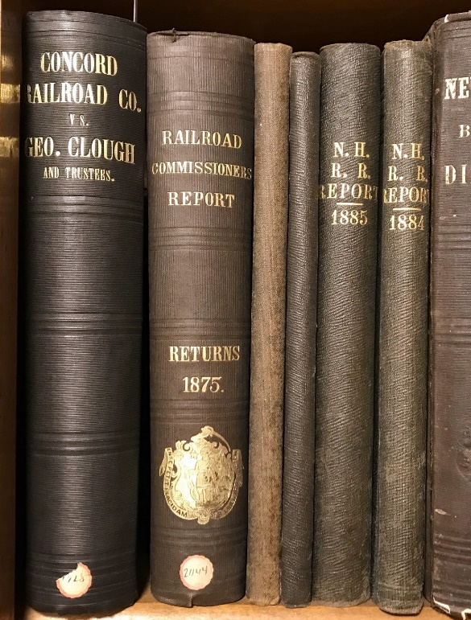
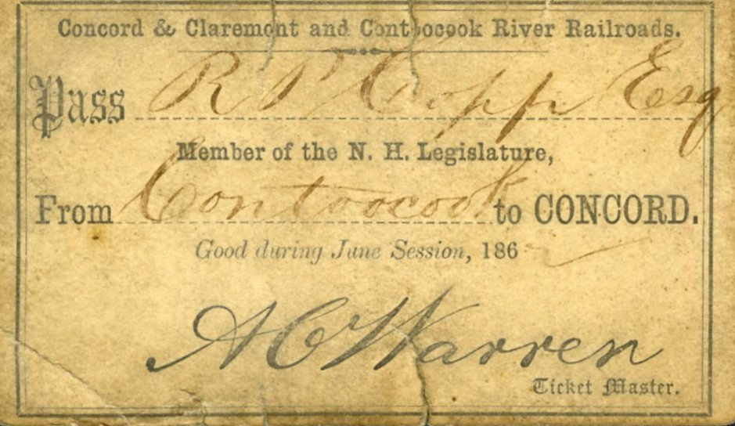
Stop #4d Railroad Workers: Labor Relations 896 Main St., Contoocook
For all of the Contoocook Village stops near the Depot (Stops 4a 4d), park in the Municipal Parking Lot beside the Contoocook Railroad Museum located at 896 Main St. If you’d like, you can get out of your car and explore the different stops in Contoocook Village on foot.
Railroad labor relations were not always smooth, as evidenced by the 1869 lawsuit of directors vs. conductors.
A set of rarely-used books on the Hopkinton Historical Society’s bookshelf consists of Railroad Reports of the 1870s through 1880s. One book on that shelf caught our attention, titled, “Concord Railroad Co. Vs. Geo. Clough and Trustees.” We were wondering what we could learn about life during the railroad era, who was George Clough, why was there a lawsuit, and why was the book on the Society’s shelf?
Here’s what we learned. George Clough (1817-1895; son of Rachel Clifford & Isiah Clough; husband of Eliza Hardy) was a Railroad conductor, living in Concord, NH, at the time of the 1869 lawsuit where the Board of Directors of Concord Railroad accused him and all the conductors of stealing money from passenger train fares; all of the conductors were summarily fired. The case was tried by John Hatch George (of Concord and Hopkinton; he served on the Board of Directors of Contoocook Valley Railroad, and was attorney for Concord Railroad). A hand-written opinion found in the book reads, “Interesting insight into management operations; the [RR] Line, to cover poor management, fired all the conductors over an illegal ticket transaction which had been authorized by the line superintendent, General B. F. Butler; some of his former officers of the Army of the James were the detectives.” The copy of the book at Hopkinton Historical Society reads, “Compliments of George Clough,” who self-published the entire legal record in order to shed light on the tense relationship between directors and conductors.
A set of railroad reports from the 1870s-1880s uncovered interesting information about local labor relations. HHS collection.
Members of the N.H. Legislature received free passes to ride the railroad. William Eaton Chandler, in his 1891 book commonly known as “Book of Bargains,” claimed that railroads “corruptly govern New Hampshire” through the use of railroad passes and railroad money. Rail pass from HHS collection.
Hopkinton Historical Society Celebrating Hopkinton History Since 1859

Slide 28
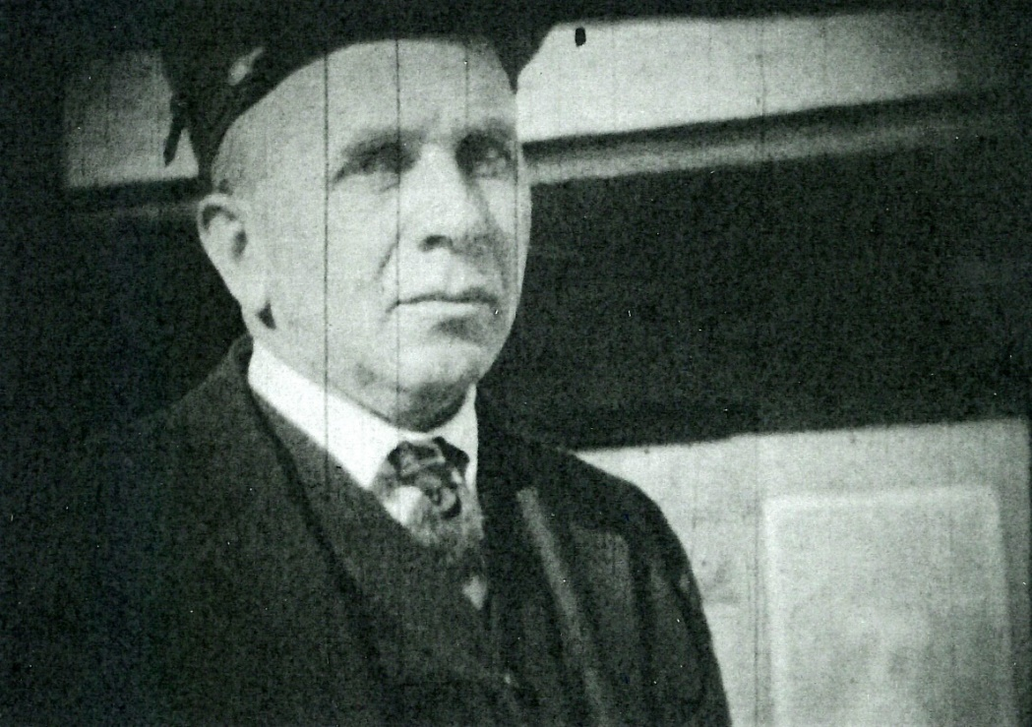
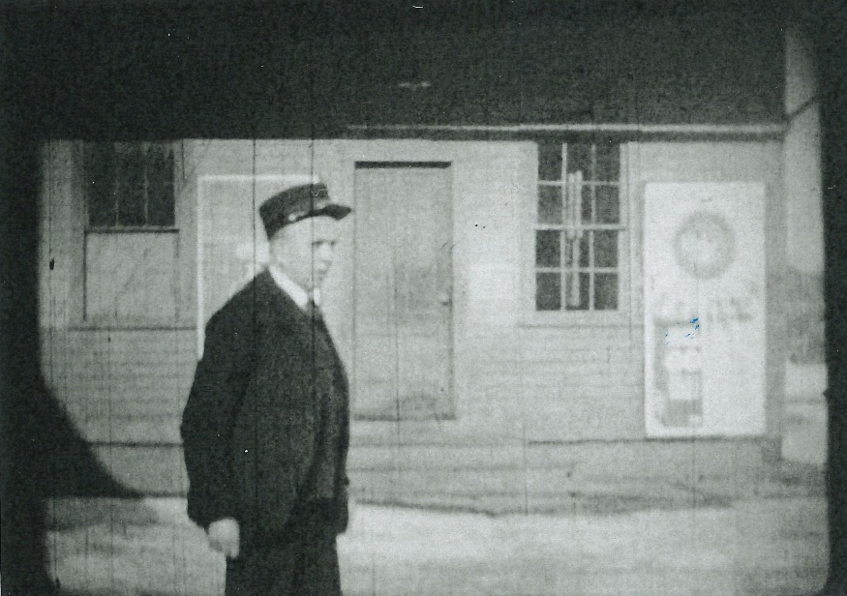
Stop #4d Railroad Workers: Forrest Gillingham 896 Main St., Contoocook
For all of the Contoocook Village stops near the Depot (Stops 4a 4d), park in the Municipal Parking Lot beside the Contoocook Railroad Museum located at 896 Main St. If you’d like, you can get out of your car and explore the different stops in Contoocook Village on foot.
Forrest Gillingham (1874-1953) served as Station Agent at the Contoocook Depot for many years. He is listed as such in the 1910 census; the Society has images of him wearing a Station Agent’s hat in front of the Depot circa 1930; and Ken Smart remembers Mr. Gillingham as the Station Master while he worked for the railroad from 1947-1952.
Station Agents are typically the person in charge of a railway station. Duties might vary from station to station, but generally were responsible for control of traffic (telegraphy and signaling) under the direction of the dispatcher. Their station duties included ticket sales, processing of packages and local freight shipments, mail handling, etc.
Still images of Forrest Gillingham taken from film by Oscar Polhemus, circa 1930. HHS collection.
Hopkinton Historical Society Celebrating Hopkinton History Since 1859

Slide 29
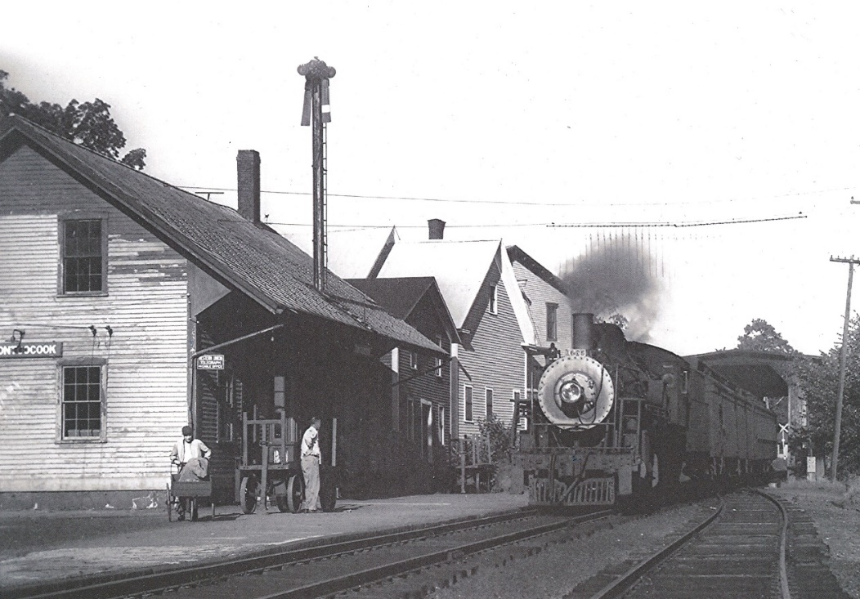
Stop #4d Railroad Workers: Ken Smart 896 Main St., Contoocook
For all of the Contoocook Village stops near the Depot (Stops 4a 4d), park in the Municipal Parking Lot beside the Contoocook Railroad Museum located at 896 Main St. If you’d like, you can get out of your car and explore the different stops in Contoocook Village on foot.
Photograph of Ken Smart (left) and Jim Dalby (right) at the Contoocook Depot, c. 1950. Photo courtesy of Ken Smart.
I spent many hours at the Depot working for Forrest Gillingham, the station agent at that time. The timeframe would have been starting about 1947 until June 1952. Those were my Junior and Senior High School years.
I met four trains a day, six days a week as usually we had Sunday’s off because the mail did not run on Sunday.
The duties were many but probably the most important was to insure the mail got from the Post Office to the train and back again. Luckily we did not have far to go as the Post office was located where Kerry’s Carpets [190 Pine St, Contoocook, NH] is today. I wonder what became of that three wheel push cart you can see me with in the attached picture?
As I remember the schedule, the first train of the day was around 8:00 am from Claremont and returned at 10:30 am from Concord. I would get out of school to meet the train thanks in part to Bill and Doris Milne, two of the teachers at that time.
The afternoon schedule was 5:00 pm from Claremont and return from Concord around 7:00.
The job of keeping the old coal fired furnace running and the ashes removed was not a lot of fun nor was mopping the hardwood floors that were badly worn in places. But the overall job was a good experience for a teenager at that time even though it required taking a lot of teasing about it from my peers.
I never got to really operate the telegraph key as the speed of the operators on the line was faster than I could keep up with. Mr. Gillingham was quite proficient with the key as that was the main means of communication between train stations at that time.
Portion of a letter written by Ken Smart to the Contoocook Riverway
Association during the restoration of the Contoocook Depot
Hopkinton Historical Society Celebrating Hopkinton History Since 1859

Slide 30
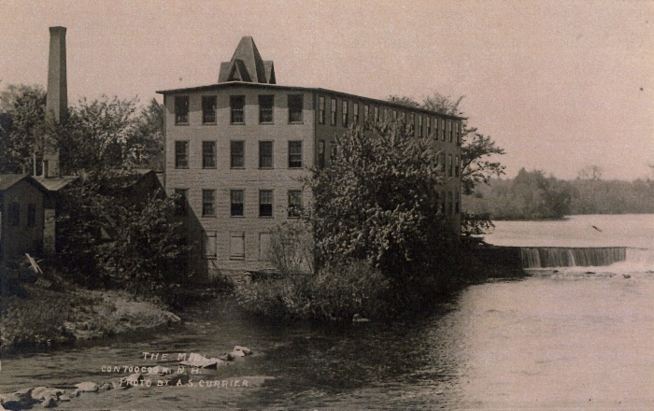
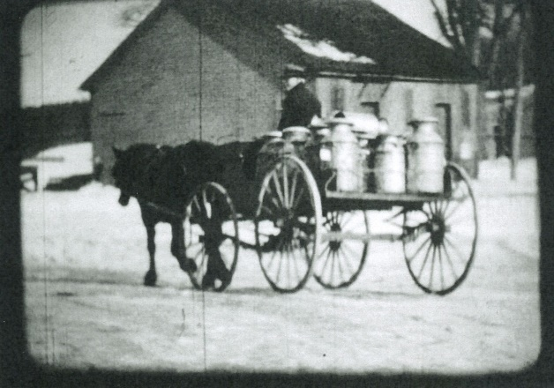
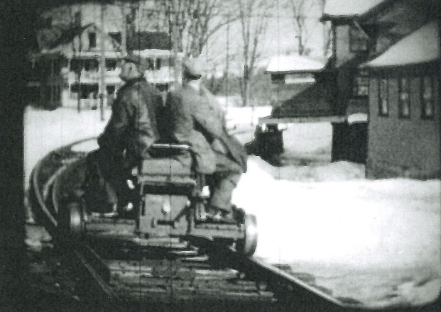
Stop #5a Contoocook Village: Businesses and the Railroad Municipal Parking Lot adjacent to 44 Cedar St.
For Stops 5a-5d, park in the Municipal Parking Lot adjacent to 44 Cedar St. If you’d like, you can get out of your car and explore the different stops in Contoocook Village on foot.
The coming of the railroad reinforced Contoocook Village as the business hub for Hopkinton. By the 1880s, there were numerous stores doing thriving business, including the Curtice & Co. department store; the W.S. Rand dry goods store; a boots and shoes establishment; Miss Julia Johnson's ladies' hats and small wares shop; the Dexter Ladd store selling hardware, stoves and plumbing fixtures; the F.H. Reed drug and stationary store; Reddy's Meat Market; and Marshall's general store. In addition, there were two doctors' offices, a barber shop, a photographer's studio, the justice of peace, and the town clerk's office. There were also a number of mills utilizing the available water power of the Contoocook River, including a grist mill; a lumber and saw mill making wooden box parts; and a manufacturer of oak handles. The largest mill was located where the Cedar Street municipal parking lot is today, next to 44 Cedar St. In 1899 a three-story wooden mill was built by Henry C. and Walter Scott Davis to make machines which turned out paperboard boxes.
By 1858, less than 10 years following the arrival of the railroad, there were a number of manufacturers and shops in Contoocook, including carpenter shops, cooper shop, woolen mill, mackerel kit manufactory, sawmill, grist mill, shingle mill, carriage shop, and others. Below are three businesses that were in operation in the early 20th century.
Kingsbury & Davis: In the 1890s, Kingsbury & Davis built a three-story wooden building on Cedar Street in Contoocook to build machines which folded all kinds of paperboard boxes. The company employed more than 100 people and the machines they manufactured were shipped by freight all over the country. The building, which was torn down in the 1960s, was located where the Cedar Street municipal parking lot is located today.
Contoocook Dairy: With the introduction of the railroad to town, farms could have their dairy products shipped by freight train. In 1890, Deerfoot Farm ran a creamery which was located on Cedar Street in Contoocook Village with easy access to the freight depot, thus opening access to new markets. The creamery changed hands several times over the next several decades. But by the 1930s, with changes in the dairy industry, both regulatory and technological, milk was being collected by truck, instead of transported by train – one of many signs of the waning importance of the railroad in town.
Nelson Grain Mill: The Lewis A. Nelson Grain Mill sat on the slip of land between the Contoocook River and the point where the railroad lines split off to either Warner or West Hopkinton. The proximity to these two features, the river and the railroad, was not coincidental. Water power and the ability to move product by rail helped ensure business success. A mill operated at this location from the early 1900s to 1937, when a fire destroyed it. Today it is the site of the Hopkinton Fire Department.
Top: Postcard image of Kingsbury & Davis. Middle: Still image of milk being delivered to the Contoocook Depot from film by Oscar Polhemus, circa 1930. Bottom: Still image Phil Ball and Irving Hicks rounding the curve of the railroad on a hand car with the Nelson Grain Mill on the right. From film by Oscar Polhemus, circa 1930. HHS collection.
Hopkinton Historical Society Celebrating Hopkinton History Since 1859

Slide 31
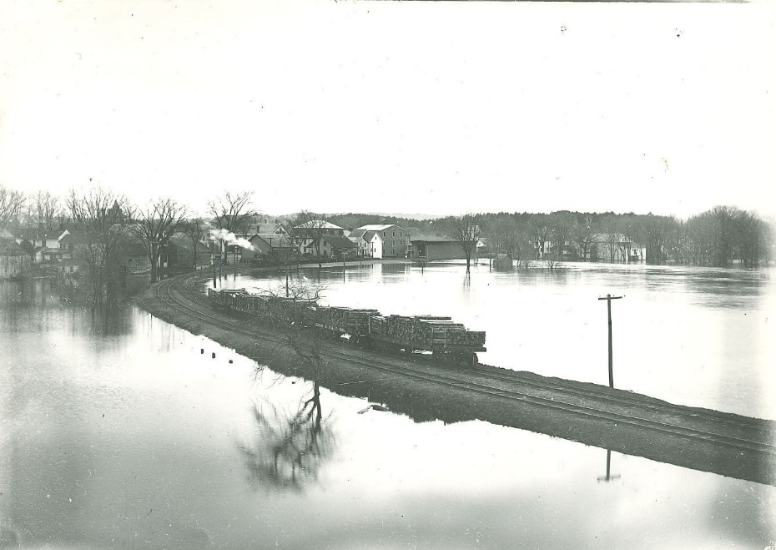
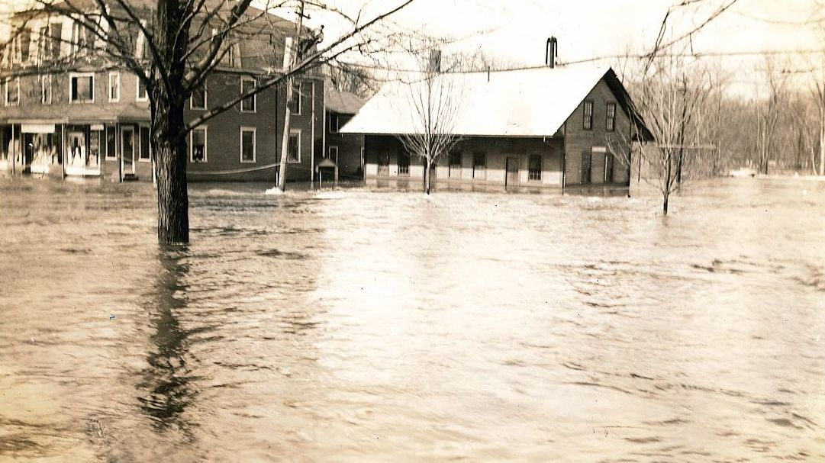
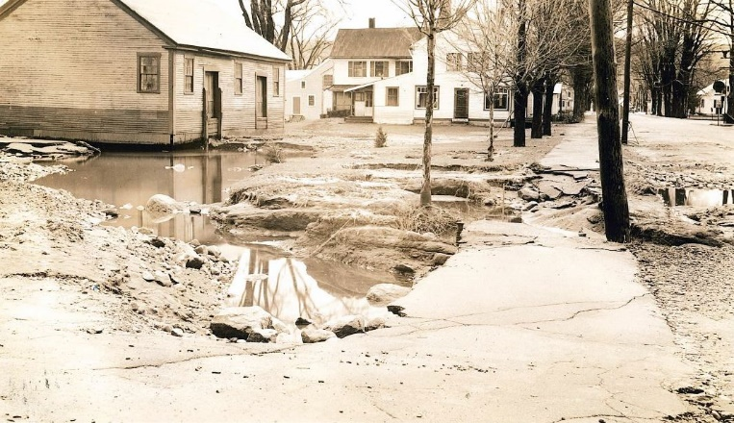
Stop #5b Contoocook Village: Disasters in the 1930s Municipal Parking Lot adjacent to 44 Cedar St.
For Stops 5a-5d, park in the Municipal Parking Lot adjacent to 44 Cedar St. If you’d like, you can get out of your car and explore the different stops in Contoocook Village on foot.
Although flooding in Contoocook Village was not uncommon, the two successive storms of 1936 and 1938 caused so much damage to businesses and homes that state and federal authorities began to look for solutions to control the Contoocook River from breaching its banks.
Locally, areas along the Contoocook River were the hardest hit during the flood of 1936. The rushing water and ice pushed the covered railroad bridge off of its abutments, countless homes and businesses were damaged, and Fountain Square was under two feet of water.
The flood of 1936 and the hurricane of 1938 led to the building of the Hopkinton-Everett Dam. Several homes and nearly 4,000 acres of land in Hopkinton were taken for the dam and the accompanying flood control areas.
Undated image of a train full of lumber heading into the Contoocook Depot with high waters on both sides of the track. HHS collection.
Images of the Contoocook Depot (left) and the freight house (right) following the flood of 1936. HHS collection.
Hopkinton Historical Society Celebrating Hopkinton History Since 1859

Slide 32
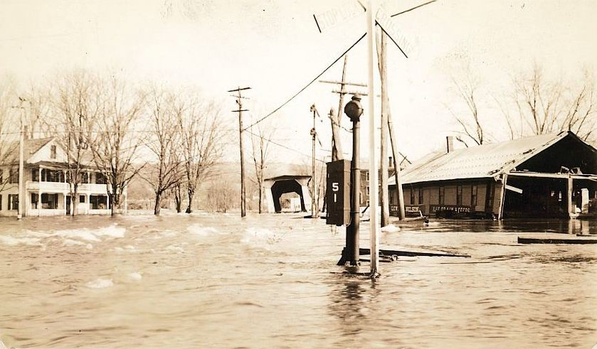
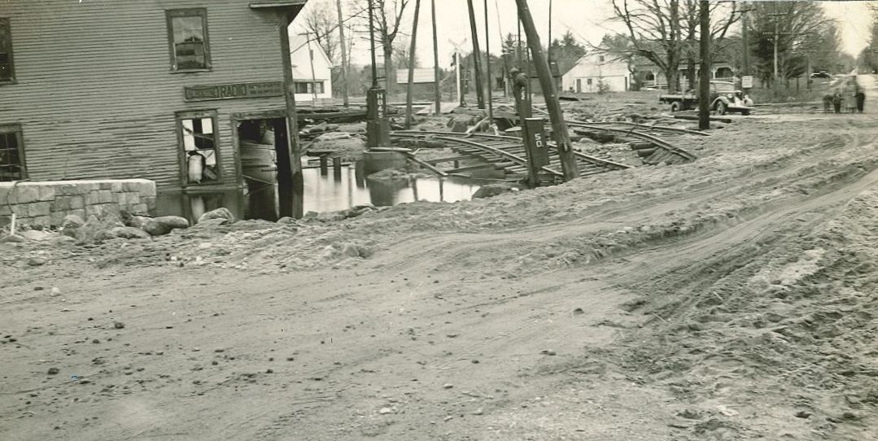
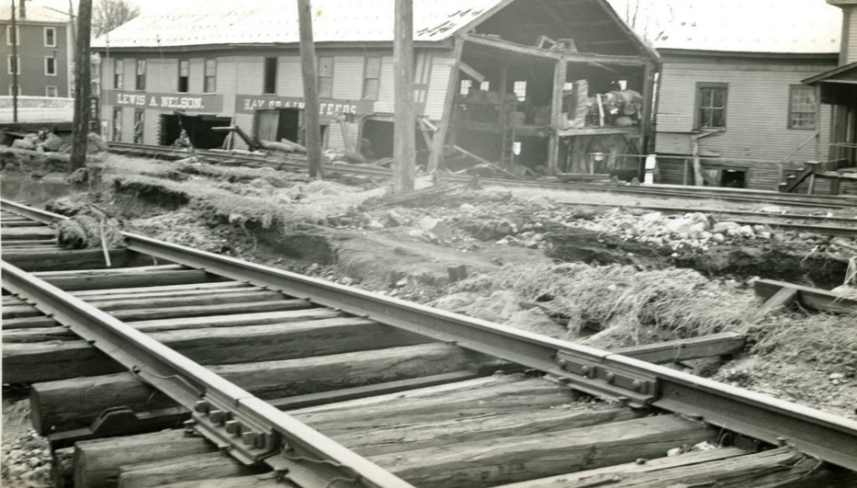
Stop #5b Contoocook Village: Disasters in the 1930s Municipal Parking Lot adjacent to 44 Cedar St.
For Stops 5a-5d, park in the Municipal Parking Lot adjacent to 44 Cedar St. If you’d like, you can get out of your car and explore the different stops in Contoocook Village on foot.
One of the businesses which suffered extensive damage from the flood of 1936 was the Nelson Grain Mill, which was sheared in half. Also visible in the photos is the damage to the railroad tracks. HHS collection.
All images HHS collection.
Hopkinton Historical Society Celebrating Hopkinton History Since 1859

Slide 33
Stop #5c Owners and Investors Municipal Parking Lot adjacent to 44 Cedar St.
For Stops 5a-5d, park in the Municipal Parking Lot adjacent to 44 Cedar St. If you’d like, you can get out of your car and explore the different stops in Contoocook Village on foot.
The 1840s saw an explosion of railroads in New Hampshire as multiple lines competed to be the first to connect new markets. Many Hopkinton residents were opposed. In 1844, several years before there was any prospect of a railroad going through the town, Hopkinton’s elected representatives to the General Court were opposed to the railroad and its use of eminent domain (the right of the government to take private property, or allow it to be taken, for public uses).
Less than five years later, opinions in Hopkinton had changed. Townspeople were caught up in “railroad fever” and had invested heavily in railroad companies. Yet when assessments were placed upon the original stock for the completion of the enterprise, many investors merely wanted to be rid of their obligations. In his book, Life & Times in Hopkinton, N.H., C.C. Lord states, “…many people made heavy sacrifices. The aggregate loss to Hopkinton residents was very large. Many thousands of dollars were the cost of a blind zeal…”
In addition, local people who supplied furnishings for the road and labor suffered losses when they were paid in stock, which later became worthless.
Image of 1849 assessment on Concord and Claremont Railroad investors requesting payment of 30% assessment. HHS collection.
Hopkinton Historical Society Celebrating Hopkinton History Since 1859

Slide 34
Stop #5d Incorporation of the Contoocook Valley Railroad, 1849 Municipal Parking Lot adjacent to 44 Cedar St.
For Stops 5a-5d, park in the Municipal Parking Lot adjacent to 44 Cedar St. If you’d like, you can get out of your car and explore the different stops in Contoocook Village on foot.
Image of the cover of the By-Laws of the Contoocook Valley Rail Road. HHS collection.
Among the Society’s rarely examined documents is the incorporation document for the Contoocook Valley Railroad. A small booklet, it starts with an enactment by the New Hampshire Senate and House, that Hamilton Perkins and 17 other men are made the “body corporate by the name of the Contoocook Valley Railroad.” It authorizes them to “locate, build, and maintain a railroad not exceeding six rods in width, with necessary additions for cuttings ….”
Hamilton Eliot Perkins (1806-1880) lived at what we call Perkins Manor, in that part of Contoocook Village center that forms the V between Park Ave. and Kearsarge Ave. (Hamilton’s father, Roger Eliot Perkins, came to Contoocook from Salem, Mass.; he built Perkins Manor around 1825.) Hamilton also resided in Boston, where he owned several ships and was engaged in the Africa trade. In Contoocook, Hamilton owned several mills along the river; he was also postmaster, a well-respected Concord lawyer, and had considerable wealth and real estate. For Perkins, the railroad may have seemed like a perfect solution to a business problem. As a mill owner and a shipper, trains would provide a way of getting products of his trade to markets. The train project was funded by bonds; local citizens purchased $100 bonds expecting a return on their investments. Eminent domain laws – the expropriation of private property for public use – were being tested in the acquisition of land for tracks.
Image of the Contoocook Valley Railroad bond, which offered investors $4 for every $100 bond purchase. HHS collection.
Hopkinton Historical Society Celebrating Hopkinton History Since 1859

Slide 35
Stop #5d Perkins Manor, Home of Hamilton Eliot Perkins Municipal Parking Lot adjacent to 44 Cedar St.
For Stops 5a-5d, park in the Municipal Parking Lot adjacent to 44 Cedar St. If you’d like, you can get out of your car and explore the different stops in Contoocook Village on foot. To see Perkins Manor, walk to the stone highway bridge. Perkins Manor is directly ahead, in the V between Park Ave. and Kearsarge Ave.
Hamilton Perkins didn’t stay on the Board of Directors for long, but the rail line was built and opened in 1849 (the section from Contoocook Station to Hillsborough Bridge; later leased to the Concord & Claremont Railroad).
Perkins Manor would remain visible to riders, as described in The Bay State Monthly in April 1884, “In passing up the Concord and Claremont Railroad from Concord, the observant traveler has doubtless noticed the substantial and comfortable-looking homestead with large and trim front yard, shaded by thickly planted and generous topped maples, on the right-hand side of the road after crossing the bridge that spans 'Contoocook's bright and brimming river' at the pleasant-looking village of Contoocookville in the northern part of Hopkinton."
Portrait of Hamilton Eliot Perkins as a young man. HHS collection.
Photograph of Perkins Manor. HHS collection.
Photograph of railroad tracks and crossing. In the background is Perkins Manor (partially obscured by trees). HHS collection.
Hopkinton Historical Society Celebrating Hopkinton History Since 1859

Slide 36
Stop #6 Stevens Rail Trail 61 Houston Dr. (parking for Rail Trail)
Parking is behind the library as there is not any parking for the Stevens Rail Trail at the southern entrance. There are a few parking spots at the northern end on Kearsarge Ave.
The Stevens Rail Trail is a former railroad bed now used as a multi-purpose trail. It starts on the north side of Spring Street near Krzyzaniak Lane and continues for approximately two miles, ending at Kearsarge Avenue near Interstate 89 Exit 7 and the entrance to Knoxland Equipment. In 2019 this trail was improved in cooperation with Friends of the Concord-Lake Sunapee Rail Trail.
Directions: Park at Houston Fields behind the Library (61 Houston Drive). After parking, follow the gravel road next to the playground towards the back athletic fields. Just after reaching the field, turn right on another gravel path and follow it through the woods to Spring Street. The trail starts on the north side of Spring Street at the beginning of Krzyzaniak Lane.
Hopkinton Historical Society Celebrating Hopkinton History Since 1859

Slide 37
Stop #6 Stevens Rail Trail 61 Houston Dr. (parking for Rail Trail)
Parking is behind the library as there is not any parking for the Stevens Rail Trail at the southern entrance. There are a few parking spots at the northern end on Kearsarge Ave.
A sampling of sites along the Stevens Rail Trail, clockwise from upper right: The mile post marker CJ 44, indicating the Claremont Junction is 44 miles away. The photo beside it is of the rail rest located near the mile post marker. These rail rests were used to store spare rails in case repairs were needed. In the bottom right is a photo of lady’s slippers, which bloom in abundance along the trail in late Spring. The last two photos are of rocks located near the power lines. Look closely at the photos and you can see letters and numbers.
Hopkinton Historical Society Celebrating Hopkinton History Since 1859

Slide 38
Stop #7a West Hopkinton: West Hopkinton Station Contoocook Reservoir Viewpoint, plus code: 57Q2+97 Hopkinton
From the Contoocook Reservoir Viewpoint, you can walk or drive (app. 0.5 miles) to where the West Hopkinton Station was located. Cross over the dam, continue on Maple St. and drive through Rowell Covered Bridge. West Hopkinton Station was located on the right.
In 1849, having departed from the train station in Contoocookville (as the village was then called) heading west, the first stop on the new Contoocook Valley Railroad was West Hopkinton. This line, having been built with the lumber provided by Hopkinton’s own citizen, Joseph Barnard, followed much of the Contoocook River. From the passenger car a rider could see farms, and fields, woods and homes. The river was an integral feature for the residents of the community. It was the Contoocook River which provided the energy to power the saw mills, grist mills and other industrial mills which could also be seen along the railroad.
At a bend in the river, near the western border of the Town of Hopkinton, a small station was built to provide access to the railroad for passengers and freight. The West Hopkinton station was positioned on the north side of the river, just at the junction of the Rowell Bridge which provided access to the opposite side of the river where many of the mills were built. West of the station, on the river, a dam had been built to better harness the water power for industries.
Continuing west, the railroad passed into the next town, Henniker, stopping, then continuing on, making its final stop at Hillsborough Bridge. It was at Hillsborough passengers and freight would soon be able to make connections to Peterborough and beyond. The return trains, those heading east to Contoocookville, allowed passengers and freight a connection to the, also new, Concord and Claremont Rail Road providing access to markets well beyond the confines of Hopkinton, or even Merrimack County.
Images of the West Hopkinton station and the location of the station relative to the Rowell Covered Bridge. HHS collection.
Hopkinton Historical Society Celebrating Hopkinton History Since 1859

Slide 39
Stop #7b West Hopkinton: Davis Paper Company Contoocook Reservoir Viewpoint, plus code: 57Q2+97 Hopkinton
From the Contoocook Reservoir Viewpoint, you can walk or drive (app. 0.5 miles) to where the Davis Paper Company was located. Cross over the dam, continue on Maple St. until you get to the very sharp curve near the Rowell Covered Bridge. Davis Paper Company was located directly across from the white structure at the sharp curve.
Photograph of Henry Chase Davis, one of the owners of Davis Paper Company in West Hopkinton. HHS collection.
The area along the Contoocook River at West Hopkinton has been the site for several mills since early in Hopkinton’s settlement. The bend in the river and the drop in elevation adds to the power the river provides to turn the wheels to saw lumber and grind grain. With the introduction of the railroad through this area in 1849, transporting goods beyond the Town’s borders to new and larger markets became feasible.
But the mill that had the biggest impact on the area was the paper board and leather board manufacturer – Davis Paper Company. In 1906 Henry C. Davis and his brother Horace J. Davis, having recently sold their mills in Davisville, bought the Rowell family farm and the water rights from Frank H. Carr, with the intention of building new mills. The mill buildings would contain state-of-the-art manufacturing machinery; a new dam was constructed; tenement housing for workers was built; and electricity and telephone were brought in. In addition to these buildings, the Davis’s built a warehouse on the opposite side of the river, next to the railroad station.
The railroad company, by then owned by Boston & Maine Railroad, added new side tracks to accommodate the shipping of finished goods and the receiving of raw materials. Taking more than two years to complete, it was such an accomplishment that the Davis’s opened the mills to the public for a night of dancing and music. A special train was hired to carry people to and from the festivities. By several accounts, it was a most exciting celebration with between 500 and 600 people in attendance from several towns.
The Davis Paper Company changed the character of West Hopkinton, bringing in a new population of workers with their families, who needed groceries and sundries which they could buy at the Davis General Store. The West Hopkinton Post Office moved into the store too. And the children attended school in the one-room school house across the covered bridge, near the railroad station. West Hopkinton was a busy community in the early 20th-century.
In 1947 the Davis Paper Company was purchased by Hoague and Sprague which produced cardboard.
An early 20th-century postcard with a colorized photo of the mills at West Hopkinton. Visible in the foreground are the railroad tracks that delivered fuel to the facility. HHS collection.
Hopkinton Historical Society Celebrating Hopkinton History Since 1859

Slide 40
Stop #7c: West Hopkinton: Hopkinton-Everett Dam Contoocook Reservoir Viewpoint, plus code: 57Q2+97 Hopkinton
From your location at 1433 Maple St. (Rt. 127), you can walk or drive to the Contoocook Reservoir Viewpoint by continuing on Maple St. (Rt. 127) to the intersection of Maple St. (Rt. 127) and Clement Hill Rd. About 0.5 miles.
Much of the landscape has changed in West Hopkinton since the building of the Hopkinton-Everett dam project by the Army Corps of Engineers, which began in the late 1950s. Many family farms were lost due to the construction of the dam and related reservoir and spillways. Portions of roads connecting neighborhoods, such as Bassett Mill Road, were removed. Others, such as routes 9 and 202, were rerouted, while sections of railroad track towards Henniker were removed. Additionally, the Stumpfield Cemetery had to be relocated.
The justification for such upheaval was that the Contoocook River, which had caused major flooding many times over the centuries, had again caused significant flooding twice in the 1930s. In 1936 flooding was caused by severe storms and in 1938 by a hurricane. The floods left roads washed out and much of Contoocook Village flooded, with the covered railroad bridge suffering significant, though repairable, damage. The floods also wiped out the railroad bridge to Henniker, ending rail service from West Hopkinton to Henniker. By the time the dam project was started, twenty years later, the only train service to West Hopkinton was freight, bringing in coal, via Contoocook, to power the remaining mill, until it converted to oil. By 1962, the dam construction was completed and the last railroad delivery to West Hopkinton had been made.
These two images show West Hopkinton before and after construction of the Hopkinton-Everett Dam. HHS collection.
Hopkinton Historical Society Celebrating Hopkinton History Since 1859

Slide 41
In Conclusion…
The history of Hopkinton’s railroad covers a little more than 100 years – from the first passenger train arriving in Contoocook in 1849 to the last freight train delivering coal to the paper mill in West Hopkinton in 1962. It brought tremendous change to our area – to the physical landscape, the markets for our agricultural products, and our ability to get from one place to another. It also brought changes to wealth distribution, land ownership (through eminent domain), and transient populations. Some of the changes were positive; others were less so.
Below are several questions to think about and discuss. There are no right or wrong answers to them. Instead, they are starting points to spark discussion about current experiences and lessons learned, if any, from history.
Land needed to be acquired before construction of the railroad began, some of which was done using eminent domain. Do you support the use of eminent domain? What other examples of the use of eminent domain are there (i.e., Hopkinton-Everett Dam, construction of Interstate 89)? Are there parallels with the colonists taking of land from the Native Americans?
The railroad lobby had undue influence in New Hampshire (and other states), contributing to political campaigns and offering free passes to legislators. Should businesses be allowed to lobby? How can people help ensure that more voices – not just those with the biggest budgets – are heard?
Many of us are familiar with the fate of the Concord, N.H. , railroad depot which was torn down in 1968 to make room for a shopping plaza. Do you think it is important to try and save such landmarks? Why or why not?
N.H. Senator Maggie Hassan has recently sponsored a bill (Railroad Rehabilitation and Financing Innovation Act, or RRFIA) to beef up and streamline a federal program that provides loans to help develop passenger and short line rail projects, such as the Capitol Corridor Project that would connect Manchester and Nashua to Boston via commuter rail. Are you in favor of this project? What concerns might you have? What benefits might there be?
We hope you have enjoyed our driving tour. We would love to hear your memories of train trips, or watching trains go through town. If you have images or stories you would like to share, or would like more information about Hopkinton Historical Society, please contact us at 603-746-3825, nhas@tds.net, or www.HopkintonHistory.org.
Would you please complete a brief evaluation of the driving tour? Please click here to go to the evaluation.
This program was sponsored in part by a Community Project Grant from New Hampshire Humanities, an independent nonprofit organization dedicated to connecting people with ideas. Your evaluation of this program assists your host and New Hampshire Humanities in ensuring future high-quality humanities programming. We appreciate your thoughts.
Hopkinton Historical Society Celebrating Hopkinton History Since 1859
This project was made possible with support from New Hampshire Humanities, in partnership with the National Endowment for the Humanities. Learn more at nhhumanities.org.

Slide 42
Sources
Act of Incorporation and By-laws of the Contoocook Valley Rail Road. Concord, NH. Morrill & Silsby, 1849.
Belknap, U.S.N., Capt. George E.. Captain George Hamilton Perkins, U.S.N.. The Bay State Monthly. April 1884.
Chandler, William Eaton. New Hampshire a Slave State: Senator Chandler's Series of Papers Commonly Known as the Book of Bargains. 1891.
Concord – Lake Sunapee Rail Trail. Accessed May 22nd 2020. https://concordlakesunapeerailtrail.com/.
Concord Railroad Corporation vs. George Clough and Trustees. Concord, NH. The People Steam Press, 1869.
Contoocook Railroad Museum. Accessed May 15th 2020. https://www.contoocookdepot.org/.
Hopkinton Historical Society. A Walk Through Two Villages Contoocook and Hopkinton. Hopkinton, NH. Hopkinton Historical Society, 2009.
Lord, C.C. . Life and Times in Hopkinton, N.H.. Concord, NH. Republican Press Association, 1890.
Mead, Edgar T.. Through Covered Bridges to Concord. Brattleboro, VT. Stephen Greene Press, 1970.
New Hampshire Antiquarian Society. Life and Times in Hopkinton 1735-1970. Hopkinton, NH. New Hampshire Antiquarian Society, 1989.
New Hampshire Antiquarian Society. Hopkinton New Hampshire 1765-1965. Hopkinton, NH. New Hampshire Antiquarian Society, 1965.
New Hampshire Railroad Commissioners Report. Concord, NH. Parsons B. Cogswell, 1885.
New Hampshire SP Contoocook Railroad Depot, Accessed June 17th 2020. https://catalog.archives.gov/id/77845393.
NH Stone Wall Mapper. Accessed June 22nd 2020. https://www.arcgis.com/apps/webappviewer/index.html?id=f4d57ec1a6b8414190ca0662456dffb0.
Symonds, Arthur G.. New Enterprise at West Hopkinton. Granite Monthly. November 1st 1908. 363 - 364.
Tyler, Mala Duclos. Hopkinton and Contoocook. Charleston, SC. Arcadia Publishing, 2012.
Wallace, R. Stuart. Mausolf, Lisa B.. New Hampshire Railroads: Historic Context Statement. Concord, NH. New Hampshire Division of Historical Resources, 1999.
Hopkinton Historical Society Celebrating Hopkinton History Since 1859
This project was made possible with support from New Hampshire Humanities, in partnership with the National Endowment for the Humanities. Learn more at nhhumanities.org.

